Slide 1
FUEL TAX CREDIT
February 28, 2025
CNS SAFETY AND COMPLIANCE CONFERENCE

Slide 2

Objectives
Background on the federal excise tax for fuels
Discuss the fuel tax credit and related activities which qualify for the credit
Discuss the recording keeping and filing requirements to claim the credit

Slide 3

Walz Group
Walz Group specializes in business succession, assurance, tax, and other outsourced services, including accounting, auditing, business management, tax preparation and planning, QuickBooks support, business consulting, and more.
Setting the standard for unparalleled service in pursuit of your prosperity

Slide 4

Today’s Presenter
Joshua Hoover, CPA
Josh has 8 years of experience in public accounting. He is a senior manager of the tax division at Walz Group and works with relationship managers and clients on planning and executing complex tax matters. He has experience working with partnerships, individuals, C-corporations, and S-corporations on matters involving income taxes, sales and use tax, and payroll taxes. Josh is also involved in training and mentoring new staff.

Slide 5
Disclaimer
The information discussed in today’s presentation is for educational and informational purposes only. Please consult with a tax advisor when determining how the information presented today applies to you

Slide 6

Excise Tax on Fuels
The federal government levies an excise tax on certain liquid fuels
Collected excise tax is used to fund the federal Highway Trust Fund, which funds road and transit projects

Slide 7
Excise Tax on Fuels
Sec 4041 of the tax code levies the tax on the following fuel types
  Diesel
  Kerosene
  Alternative fuels
  Compressed natural gas
  Fuels used in aviation

Slide 8
Excise Tax on Fuels
Sec 4081 of the tax code imposes the excise tax on certain activities:
  The removal of a taxable fuel from any refinery or terminal
  Entry into the United States of any taxable fuel for consumption, use, or warehousing
  The sale of a taxable fuel to any person who is not registered under Sec 4101 (generally persons or entities who import, refine, or otherwise transport fuel)

Slide 9
Fuel Tax Credit
The fuel tax credit offsets the excise tax when fuel is used for a nontaxable business purpose
If a business does not have an excise tax liability, the credit can be claimed against income taxes

Slide 10
Fuel Tax Credit
Types of fuel which qualify for the credit
  Gasoline
  Aviation gasoline
  Undyed diesel fuel
  Undyed kerosene
  Alternative fuels

Slide 11
Fuel Tax Credit
Alternative Fuels
Liquefied petroleum gas (LPG)
“P Series” fuels
Compressed natural gas (CNG)
Liquefied hydrogen
Any liquid fuel derived from coal (including peat) through the Fischer-Tropsch process
Liquid fuel derived from biomass
Liquefied natural gas (LNG)
Liquefied gas derived from biomass

Slide 12
Nonbusiness Use
IRS Publication 510 – Table 2-1. Type of Use Table
No. | Type of Use
1 | On a farm for farming purposes
2 | Off-highway business use (for business use other than in a highway vehicle registered or required to be registered for highway use) (other than use in mobile machinery)
3 | Export
4 | In a boat engaged in commercial fishing
5 | In certain intercity and local buses
6 | In a qualified local bus
7 | In a bus transporting students and employees of schools (school buses)

Slide 13
Nonbusiness Use
No. | Type of Use
8 | For diesel fuel and kerosene (other than kerosene used in aviation) used other than as a fuel in the propulsion engine of a train or diesel-powered highway vehicle (but not off-highway business use)
9 | In foreign trade
10 | Certain helicopter and fixed-wing aircraft uses
11 | Exclusive use by a qualified blood collector organization
12 | In a highway vehicle owned by the United States that isn't used on a highway
13 | Exclusive use by a nonprofit educational organization
14 | Exclusive use by a state, political subdivision of a state, or the District of Columbia
15 | In an aircraft or vehicle owned by an aircraft museum
16 | In military aircraft

Slide 14
Off-highway Business Use
Fuel used in a trade or business or in an income-producing activity other than as a fuel in
a highway registered or required to be registered for use on public highways
Includes fuel used in the following ways
  In stationary machines such as generators, compressors, power saws, or similar equipment
  For cleaning purposes
  In forklift trucks, bulldozers, and earthmovers
Does not include nonbusiness use of fuel such as use in minibikes, snowmobiles, power lawn mowers, chain saws, and other yard equipment

Slide 15
Highway Vehicle
A highway vehicle is any self-propelled vehicle designed to carry a load over public highways, whether or not it's also designed to perform other functions
A vehicle is a highway vehicle even though the vehicle's design allows it to perform a highway transportation function for only one of the following
  A particular type of load, such as passengers, furnishings, and personal effects (as in a house, office, or utility trailer).
  A special kind of cargo, goods, supplies, or materials
  Some off-highway task unrelated to highway transportation, except as discussed next

Slide 16
Vehicles not considered highway vehicles
Specially Designed Machinery for nontransportation functions
Vehicles specially designed for off- highway transportation
Nontrasnportation trailers and semi- trailers

Slide 17
Specialty Designed Machinery
All of the following conditions must apply
  The chassis has permanently mounted to it machinery or equipment used to perform certain operations (construction, manufacturing, drilling, mining, timbering, processing, farming, or similar operations) if the operation of the machinery or equipment is unrelated to transportation on or off the public highways
  The chassis has been specially designed to serve only as a mobile carriage and mount (and power source, if applicable) for the machinery or equipment, whether or not the machinery or equipment is in operation
  The chassis couldn’t, because of its special design and without substantial structural modification, be used as part of a vehicle designed to carry any other load
  The vehicle must have traveled less than 7,500 miles on public highways during the taxable year.

Slide 18
Vehicles designed for off-highway use
A vehicle which is specially designed for the primary function of transporting a particular type of load other than over the public highway and because of this special design, the vehicle's capability to transport a load over a public highway is substantially limited or impaired
Factors to consider
  Vehicle’s size
  Whether the vehicle is subject to licensing, safety, or other requirements
  Whether the vehicle can transport a load at a sustained speed of at least 25 miles per hour
Whether the vehicle can carry heavier loads off highway than it’s allowed to carry over highway is irrelevant

Slide 19
Nontrasportation Trailers and Semi-trailers
A trailer or semitrailer isn't treated as a highway vehicle if it's specially de- signed to function only as an enclosed stationary shelter for carrying on a nontransportation function at an off- highway site.
For example, a trailer that is capable
only of functioning as an office for an off- highway construction operation isn't a highway vehicle

Slide 20
Other Definitions – Public Highway
Any road in the United States that is not a private roadway
Includes federal, state, county, and city roads and streets

Slide 21
Other Definitions – Registered
A vehicle is considered registered when it is registered or required to be registered for highway use under the law of any state, the District of Columbia, or any foreign country in which it’s operated or situated
A highway vehicle operated under the dealer’s
tag, license, or permit is considered registered
A highway vehicle isn't considered registered solely because a special permit allows the vehicle to be operated at particular times and under specified conditions

Slide 22
Usage – Dual Use of Propulsion Motor
Off-highway business use doesn't include any fuel used in the propulsion motor of a registered highway vehicle even though that motor also operates special equipment by means of a power take-off or power transfer.
It doesn't matter if the special equipment is
mounted on the vehicle
Example
  The motor of a registered concrete-mixer truck operates both the engine and the mixing unit by means of a power take-off
  The fuel used in the motor to run the mixer isn't off-
highway business use

Slide 23
Usage – Use in a Separate Motor
Off-highway business use includes fuel used in a separate motor to operate special equipment, such as a refrigeration unit, pump, generator, or mixing unit.
If you draw fuel from the same tank that supplies fuel to the propulsion motor,
you must figure the quantity used in the separate motor operating the special equipment.
You may make a reasonable estimate based on your operating experience
and supported by your records.
You can use devices that measure the miles the vehicle has traveled (such as hubometers) to figure the gallons of fuel used to propel the vehicle.
Add to this amount the fuel consumed while idling or warming up the motor
before propelling the vehicle.
The difference between your total fuel used and the fuel used to propel the vehicle is the fuel used in the separate motor
Example - Hazel owns a refrigerated truck. It has a separate motor for the
refrigeration unit. The same tank supplies both motors. Using the truck's hubometer, Hazel figures that 90% of the fuel was used to propel the truck. Therefore, 10% of the fuel is used in an off-highway business use.

Slide 24
Usage – Fuel Lost or Destroyed
You can’t treat fuel lost or destroyed through spillage, fire, or other casualty as fuel used in an off-highway business use

Slide 25
Fuel Tax Credit Rates
Gasoline
  Off-highway business use – $0.183/gallon
  Use on a farm for farming purposes - $0.183/gallon
  Other nontaxable use - $0.183/gallon
  Exported - $0.184/gallon
Aviation gasoline
  Use in commercial aviation - $0.15/gallon
  Other nontaxable use - $0.193/gallon
  Exported - $0.194/gallon
  LUST tax on aviation fuels used in foreign trade - $0.001/gallon
Undyed diesel fuel
  Nontaxable use - $0.243/gallon
  Use on a farm for farming purposes - $0.243/gallon
  Use in trains - $0.243/gallon
  Use in certain intercity and local buses - $0.17/gallon
  Exported - $0.244/gallon

Slide 26
Fuel Tax Credit Rates - Continued
Undyed Kerosene
  Nontaxable use - $0.243/gallon
  Use on a farm for farming purposes - $0.243/gallon
  Use in certain intercity and local buses - $0.17/gallon
  Exported - $0.243/gallon
Alternative fuels
  Liquefied petroleum gas (LPG) - $0.183/gallon
  “P Series” fuels - $0.183
  Compressed natural gas (CNG) - $0.183/gallon
  Liquefied hydrogen - $0.183/gallon
  Fischer-Tropsch process liquid fuel from coal (including peat) -
$0.243/gallon
  Liquid fuel derived from biomass - $0.243/gallon
  Liquefied natural gas (LNG) - $0.243/gallon
  Liquefied gas derived from biomass - $0.243/gallon

Slide 27
Filing the Claims
Record keeping requirements
Form used to file the claim
Examples

Slide 28
Record Keeping
Those claiming the fuel tax credit must keep the following records:
The number of gallons purchased and used during the period covered by your claim
The dates of the purchases
The names and addresses of suppliers and the amounts purchased from each in the period covered by your claim
The nontaxable use for which you used the fuel
The number of gallons used for each nontaxable use
NEW FOR 2024 – Records related to form 4136

Slide 29
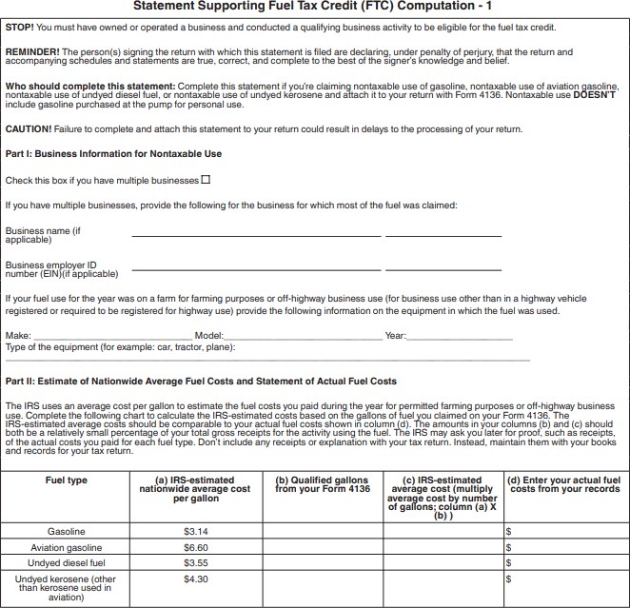
Record Keeping - Continued
Form 4136 Supplementary Statement
Must be attached to Form 4136 starting in 2024

Slide 30
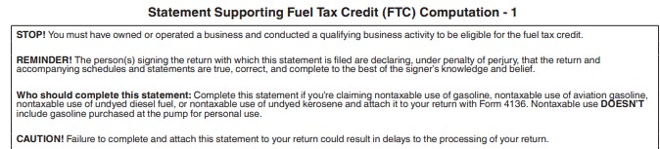
Record Keeping - Continued

Slide 31
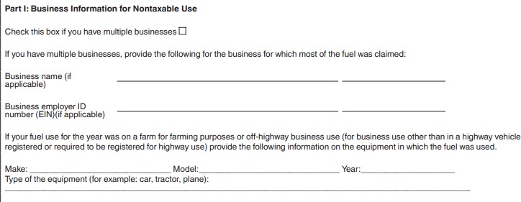
Record Keeping - Continued

Slide 32
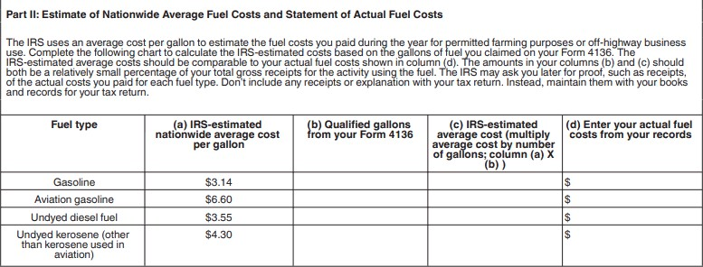
Record Keeping - Continued

Slide 33
Forms
Three ways to claim the credit:
  Form 720, Schedule C – claiming the credit against the excise tax
  Form 8849 – claiming the credit as a refund (no excise tax is filed)
  Form 4136 – claiming the credit against income taxes

Slide 34
Forms - Continued
Form 8849, Schedule 1
  Claiming the credit as a refund (no excise tax on fuel is claimed on form 720)
  Filed on a quarterly basis
    January 1 – March 1 – due by June 30
    April 1 – June 30 – due by September 30
    July 1 – Sept 30 – due by December 31
    Oct 1 – Dec 31 – due by March 31
  Total quarterly claim must be at least $750

Slide 35
Forms - Continued
Form 4136
  Claiming the credit against income taxes
  Annual filing
  Do not report any credits claimed on form 720 or 8849 during the year
  Individuals – claim the credit on their 1040
  Partnerships – pass through the credit to the partners; partners claim the credit on their individual returns
  Corporations – claim as a credit on their returns (1120 or 1120S)

Slide 36
Example 1
A calendar year C-corporation has the following expenses for gasoline and fuel tax credit claims for the year:
Calendar Quarter | Fuel Tax Expense | Fuel Tax Credit Claim
Jan 1 – March 1 | $1,300 | $1,293
April 1 – June 30 | $1,100 | $1,094
July 1 – Sept 30 | $ 400 | $ 397
Oct 1 – Dec 31 | $ 300 | $ 298
Total | $3,100 | $3,082
The corporation can deduct the entire cost of the gasoline as a business expense on its year end tax return
The corporation can claim the first quarter and second quarter tax credits on form 8849 as both exceed $750
The corporation can claim the third quarter and second quarter tax credits on form 4136 as a credit against its income tax
The total credit of $3,082 is included in the corporation’s gross Income on its income tax return

Slide 37
Example 1 - Continued
Claiming the credit results in a net benefit for the company
Gross income | $ 3,082
Tax rate | x 21%
Income tax on credit | $ 647
Fuel tax credit | (3,082)
Net refund | $ 2,435

Slide 38
Example 2
A sole proprietor has the following expenses for diesel and fuel tax credit claims for the year:
Calendar Quarter | Fuel Tax Expense | Fuel Tax Credit Claim
Jan 1 – March 1 | $10,093 | $ 668
April 1 – June 30 | $ 9,175 | $ 608
July 1 – Sept 30 | 0 | 0
Oct 1 – Dec 31 | 0 | 0
Total | $19,268 | $1,276
The proprietor has two options:
File Form 8849 and Schedule 1 to claim the total fuel tax credit. The claim would be due by September 30
File Form 4136 and claim the credit on their individual tax return The proprietor deducts the cost of the fuel on their income tax return (Schedule C) and includes the fuel tax credit in the gross income

Slide 39
Sources
Information from today’s presentation was compiled from the following:
IRS Publication 510 – Excise Taxes – Chapters 1 and 2
IRS Form 4136 and instructions
IRS Form 8849, Schedule 1 and instructions
IRS Form 720, Schedule C and instructions

Slide 40

Visit our website:
walzgroupcpa.com
Contact us:
717-392-8200
contactwg@walzgroupcpa.com

