Slide 1


CNS Companies Safety & Compliance Conference | Accident Management
Lane Brody, Esq. and Alyssa Adams, Esq. | CNS Companies Safety & Compliance Conference | February 28, 2025
A D I F F E R E N T
A P P R O A C H
© 2025 Saxton & Stump. All Rights Reserved.
1

Slide 2
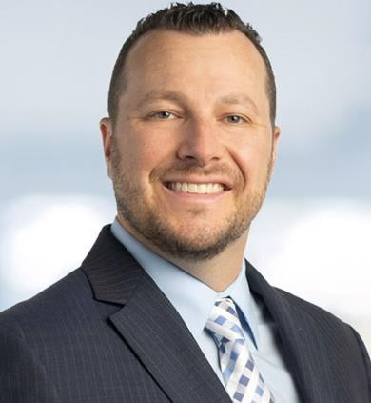
Lane E. Brody, Esq.
Shareholder & Co-Chair of the Trucking & Commercial Transportation Group
(717) 941-1215 lb@saxtonstump.com
Lane E. Brody, Esq. is Shareholder and serves as Co-Chair in Saxton & Stump’s Trucking and Commercial Transportation Group and is also a member of the firm’s Commercial Litigation Group. For close to 20 years, Lane has served clients by quickly and diligently evaluating claims in order to make informed decisions on litigation strategies while keeping his client’s best interests as his main focus. He concentrates his practice on the defense of commercial motor vehicles and their insurers as well as a variety of clients in civil litigation matters including general liability and subrogation.
Lane has frequently been named a “Pennsylvania Rising Star” by Super Lawyers and Law & Politics Magazine. His desire to assist and defend those in need began while working at a local nursing home throughout his high school years, working with disadvantaged youth during college, then at a law clinic and at the Dauphin County Bar Association during law school. Through these life experiences, he developed a passion for defending the rights of those in need, both individuals and companies alike.
Practice Areas
 Trucking and Commercial Transportation
 Commercial Litigation
2

Slide 3
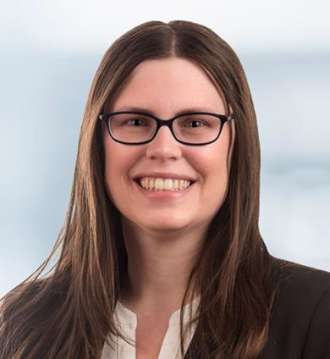
Alyssa A. Adams, Esq.
Senior Counsel
(717) 216-5503 aa@saxtonstump.com
Alyssa Adams is a member of the Saxton & Stump Trucking and Commercial Transportation Group, helping tractor-trailer drivers navigate the legal system when they are involved in an accident. She’s worked in defense of the transportation industry for more than 10 years at the former Carlisle, Pa.-based Marcello & Kivisto LLC law firm, a boutique firm that focused entirely on the legal needs of the transportation industry. At Saxton & Stump, she’ll continue her work from Marcello & Kivisto, including litigation and settlements of tractor-trailer accidents, traffic citations in court and drafting contracts for trucking companies.
Prior to joining Marcello & Kivisto, she worked as a legal intern in two offices of the Pennsylvania Office of General Counsel in Harrisburg. Her first assignment was in the Public School Employees’ Retirement System where she worked on analysis of interpreting the Pennsylvania State Employees’ Retirement Code to help decide appeals, interpreted additional codes such as securities laws, tax laws, the Right to Know Law, guardianships and others. During her final year of law school, she interned for the office’s Insurance Department, working with the state’s Medical Care Availability and Reduction of Error (MCARE) Act of 2002. In that position, she reviewed medical malpractice claims, and evaluated those cases along with complaints, answers, deposition summaries, expert reports and other legal documents.
Practice Areas
 Trucking and Commercial Transportation
 Commercial Litigation
 Litigation
3

Slide 4
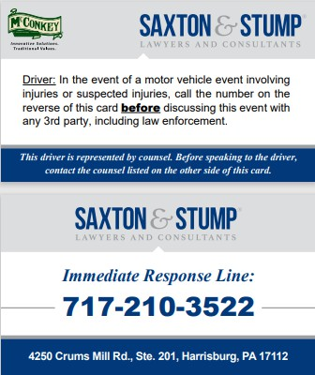

Slide 5


 Accident Response
Driver’s Role
Company’s Role
 Preventability Determinations
 Company & Driver Manuals/Handbooks
Agenda

Slide 6

Post-Accident Conduct & Instructions

Slide 7


WHY?
 Protect your driver’s interests
 Protect your company’s interests
Accident Investigation
Damage Control
Keep the meat out of the shark’s mouth

Slide 8


The first and most important step a company can take to protect themselves and their drivers is to have a plan in place NOW before the accident happens. Be prepared. You do NOT want to be scrambling to figure out what to do when you get the call in the middle of the night.

Slide 9

For many of our clients who have drivers involved in accidents, where there are known injuries or suspected injuries, they simply instruct their drivers to contact us. Any time of day. One of our trucking attorneys will answer the phone and walk the driver through the process and help them through what is typically a chaotic and stressful situation.
For those of you who we do not have the privilege of working with, we recommend that you find yourself a lawyer or firm that specializes in trucking and transportation so that they can help you.

Slide 10
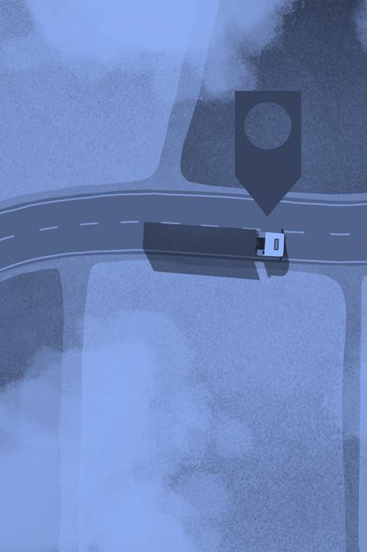
Why contact your trucking and transportation attorney?
 Help driver
 Work with law enforcement
 Start accident investigation (think: evidence at a crime scene)
 Attorney-Client privilege (if no attorney involved, all notes, emails, correspondence, etc. will be discoverable later on –damaging, inconsistent, inaccurate, etc.)

Slide 11


Help Driver
 Safety/health first
 We always want to cooperate with law enforcement but often times we instruct drivers not to provide a statement at that time (state of mind, incomplete investigation, etc.)
 Investigation (help obtain party info, witness info, photos, etc.)
 Post-accident drug/alcohol screen (if applicable)
 Stay in constant contact with driver and company and remind the driver not to speak to anyone but the lawyer
 No social media postings

Slide 12

Top Accident Response Tips for Trucking Companies
12
12
© 2025 Saxton & Stump. All Rights Reserved.

Slide 13

 Your actions and attitude after an accident matter!
 Regardless of who is at fault, always be
polite, respectful and professional.
 Remember, police have dash and body cameras
 Everyone has cell phones with recording capabilities
 Ring Cameras and Surveillance Cameras
 If you act like a jerk, it will absolutely come
back to haunt you

Slide 14

1. Act Fast and Be Prepared
 Start before the accident begins
 Train dispatchers
What to ask the driver
What information to obtain
Who to contact

Slide 15
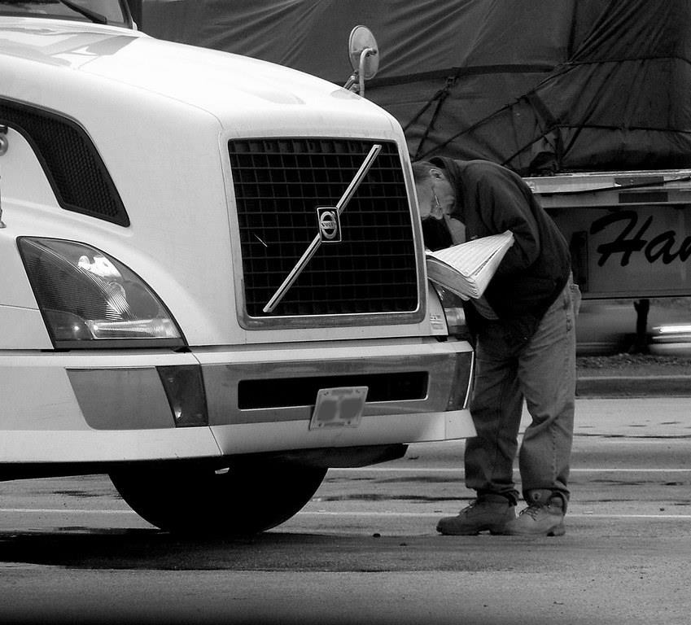
2. Do Not Take Statements from Your Driver
 Advise your driver not to give any statements or talk to anyone about the accident
This Photo by Unknown Author is licensed under CC BY-NC-ND

Slide 16
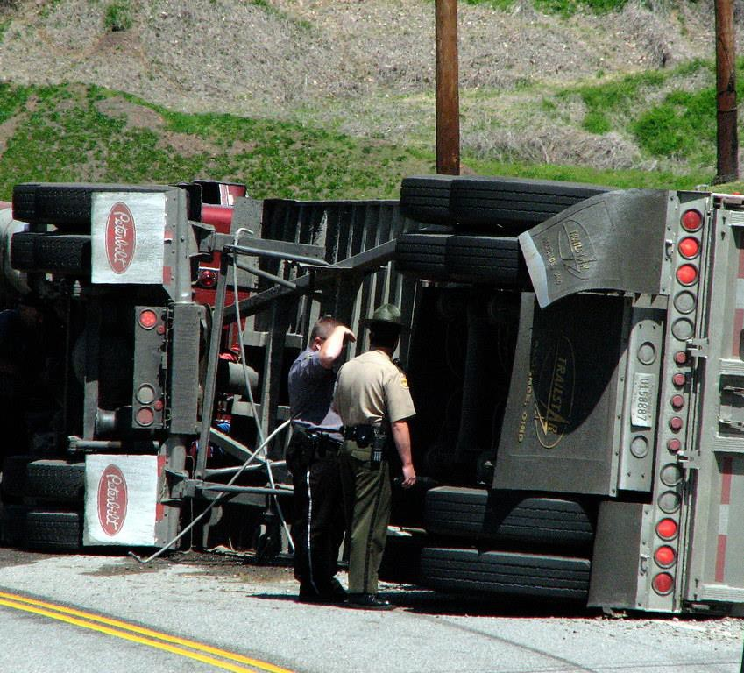
3. Bring in Outside Help
 Independent Adjuster
Obtain statements from other
driver and witnesses
Canvas for security cameras
Take pictures
 Accident Reconstructionist
 Attorney
This Photo by Unknown Author is licensed under CC BY

Slide 17

4. Social Media
 Public record search
 Social media search
Accident
  News
Other driver
  Family members
 Act fast

Slide 18
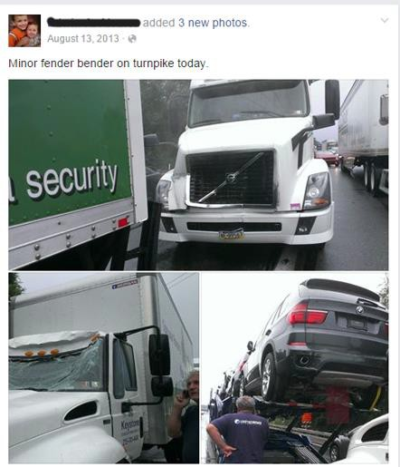

Slide 19
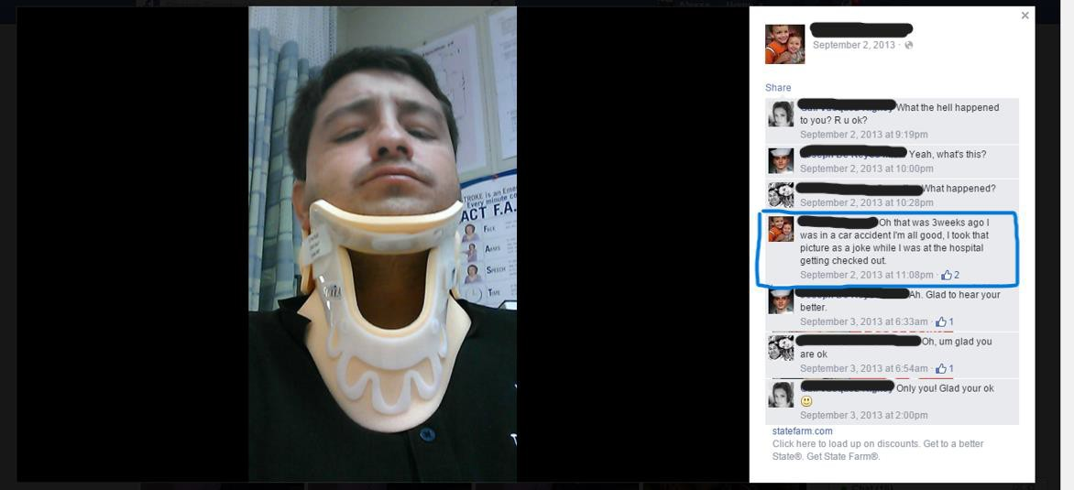

Slide 20
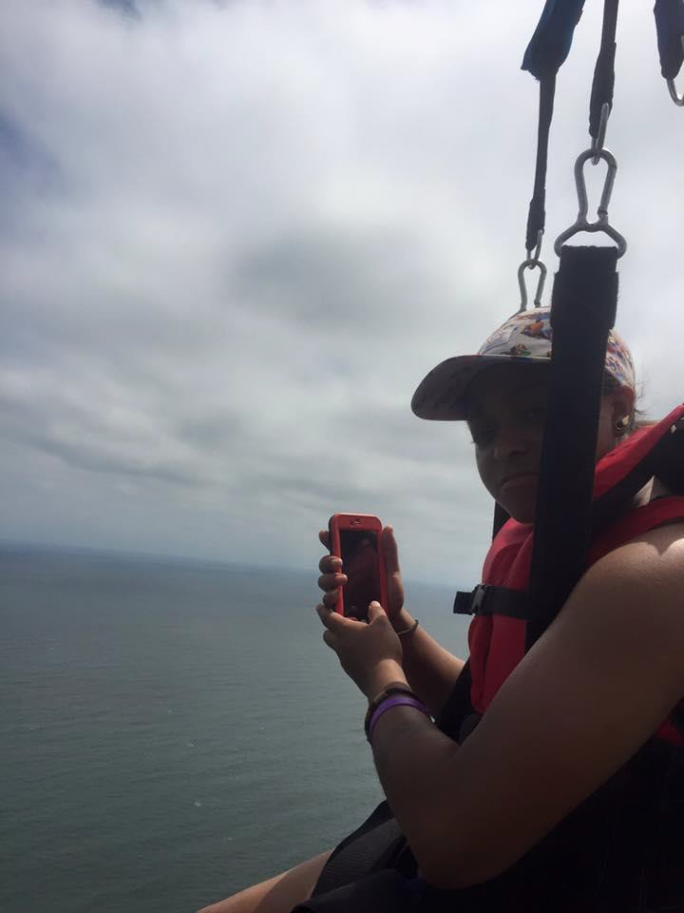

Slide 21
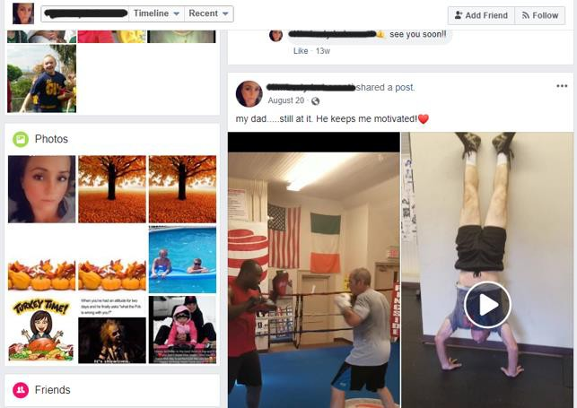

Slide 22
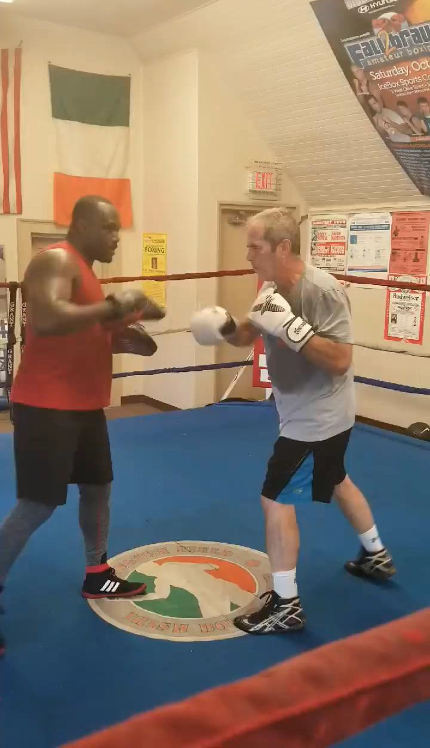

Slide 23
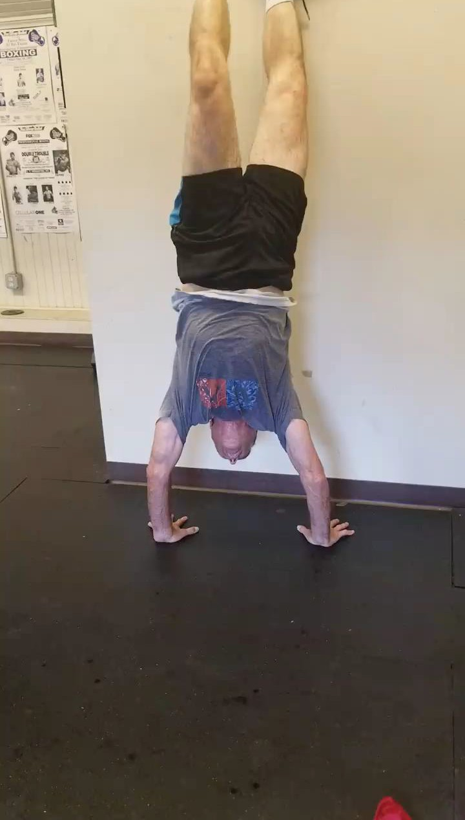

Slide 24
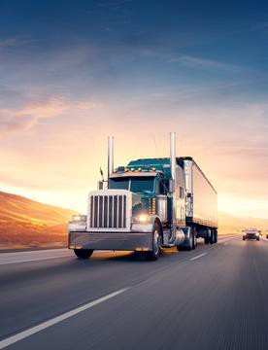
5. Preservation of evidence

Slide 25
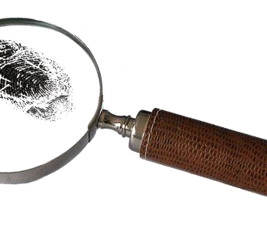
5. Preservation of Evidence
 Preserve evidence
Driver’s logs
Video
 Preservation letter

Slide 26
Accident Response Plan

Slide 27
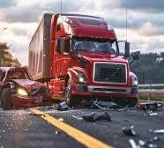
Free Accident Response Forms
 Dispatcher checklist
 Photo checklist
 Accident form
 Document preservation
 Rapid Response Plan
 If you give me a business card at the end of the presentation, I will send you our free accident response documents.

Slide 28
LET US HELP YOU WITH YOUR ACCIDENT RESPONSE!!

Slide 29

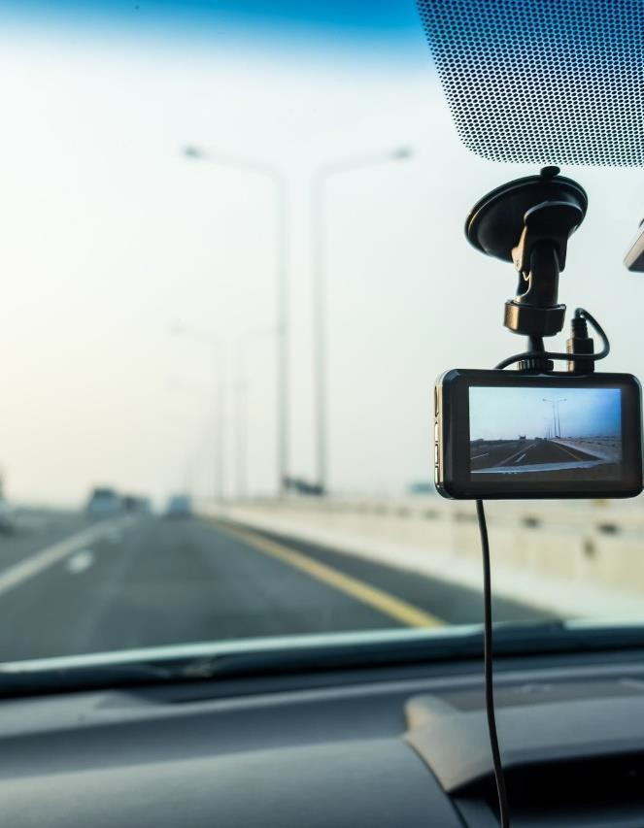
Preventability Determinations
 Premature
 Unnecessary
 Potentially Harmful
 Suspension vs. Termination
 Driver cooperation
 Address after accident investigation has been completed

Slide 30
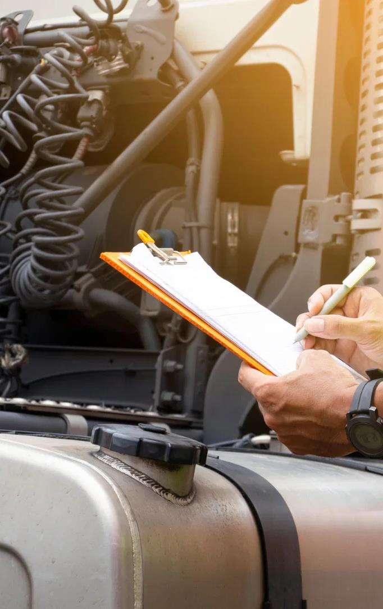


Driver/Employee Manuals
 Non-CDL vs. CDL drivers – keep them separate
 Multiple sets of rules, laws, and regulations
 Less is more (more meat for the shark to chew on if company/driver are not compliant)
 Proof of driver’s receipt/review
 Update regularly

Slide 32

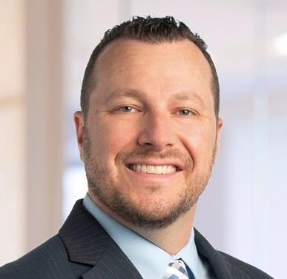
Thank you!
STAY CONNECTED WI TH US
Visit us at: saxtonstump.com
Lane E. Brody, Esq.
Shareholder & Co-Chair
Trucking and Commercial Transportation
Sign up for our e-alerts at: saxtonstump.com/e-alerts
(717) 941-1215
lb@saxtonstump.com
Follow us on LinkedIn, Facebook and YouTube

Slide 33
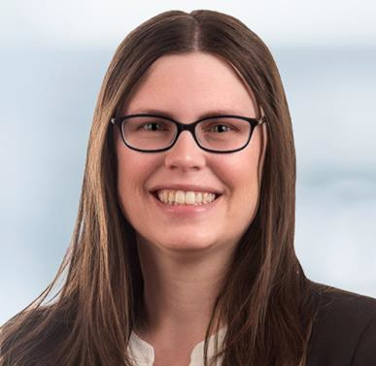
Thank you!
STAY CONNECTED WI TH US
Visit us at: saxtonstump.com
Alyssa A. Adams, Esq.
Senior Counsel
Sign up for our e-alerts at: saxtonstump.com/e-alerts
Follow us on LinkedIn, Facebook and YouTube
(717) 216-5503
aa@saxtonstump.com
33

