Slide 1


2025 Safety & Compliance Conference
Safer Together: The PMTA Advantage
Rebecca Oyler
Pennsylvania Motor Truck Association
February 28, 2025

Slide 2
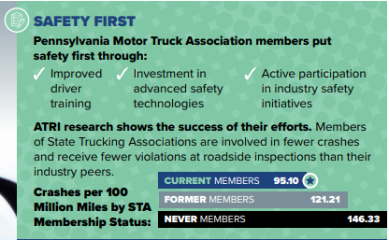

Slide 3
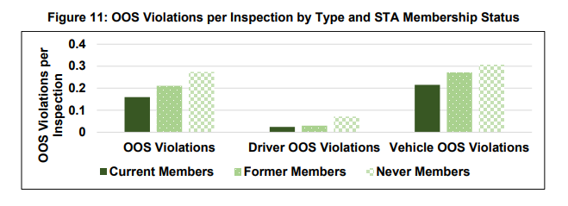

Slide 4
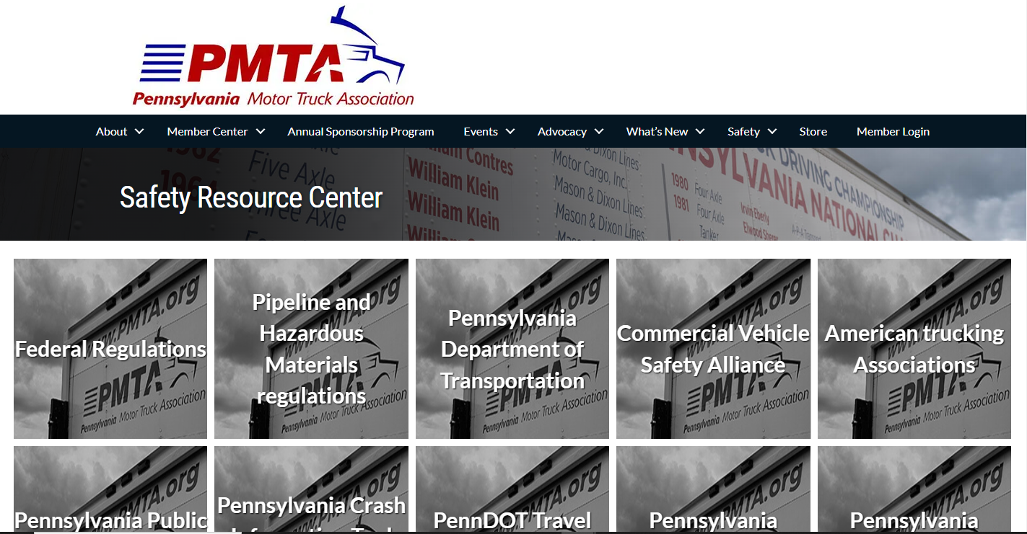

Slide 5
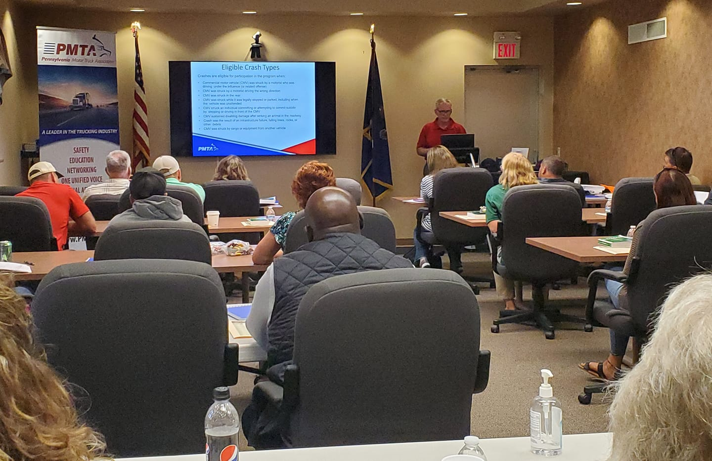

Slide 6
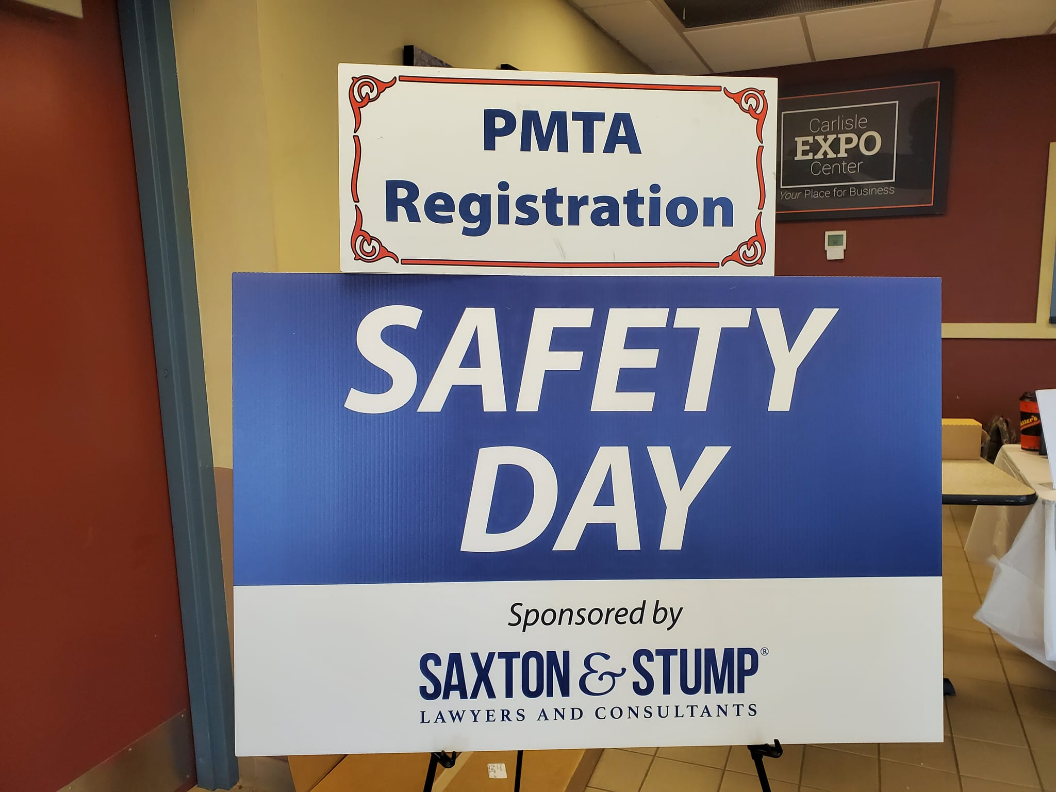

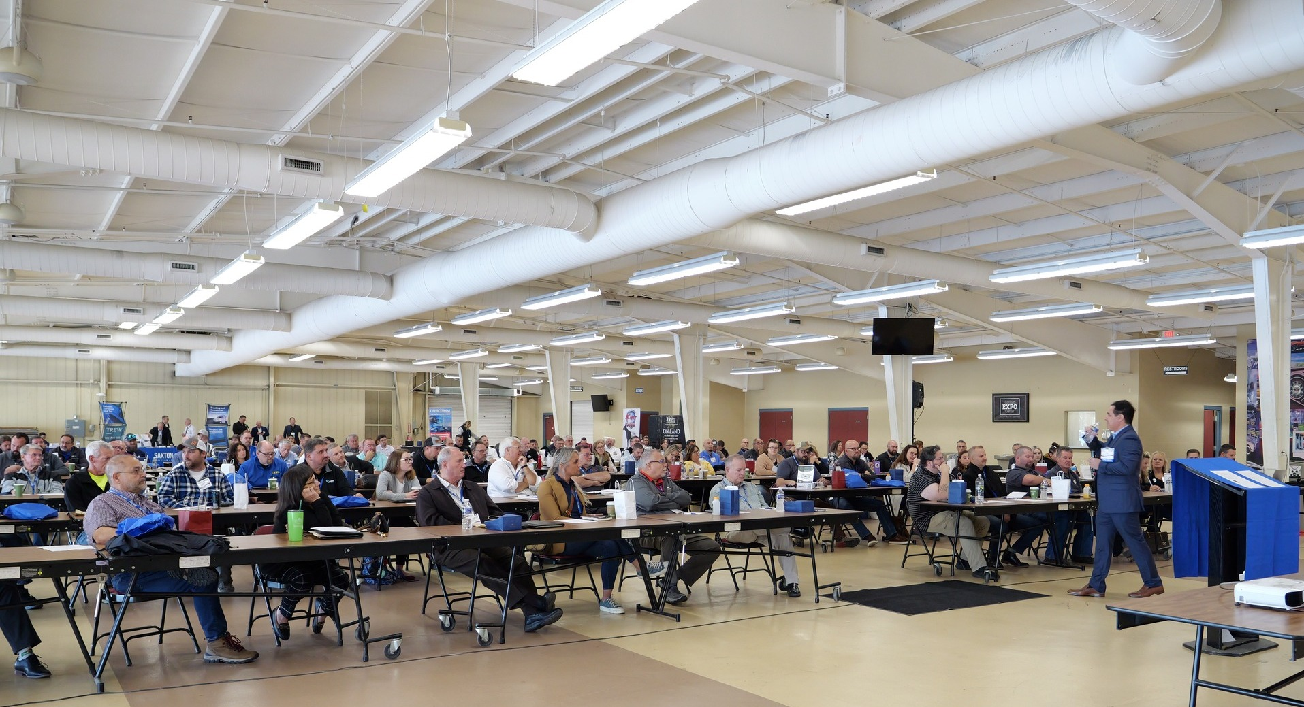

Slide 7
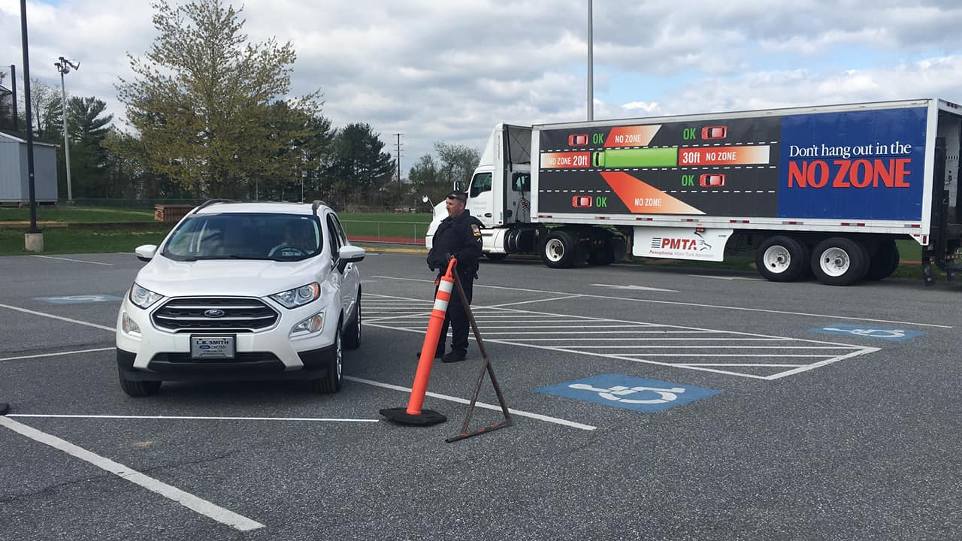

Slide 8
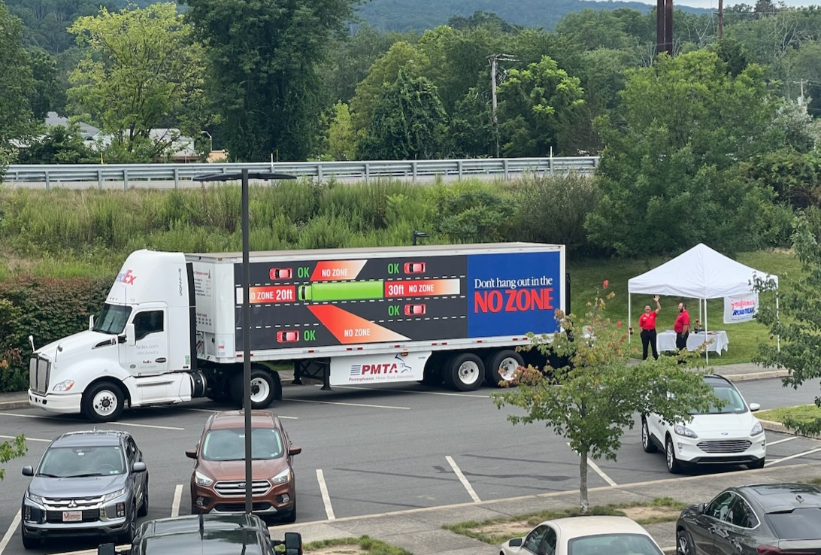
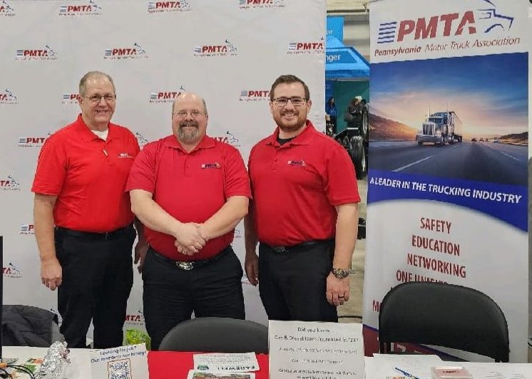
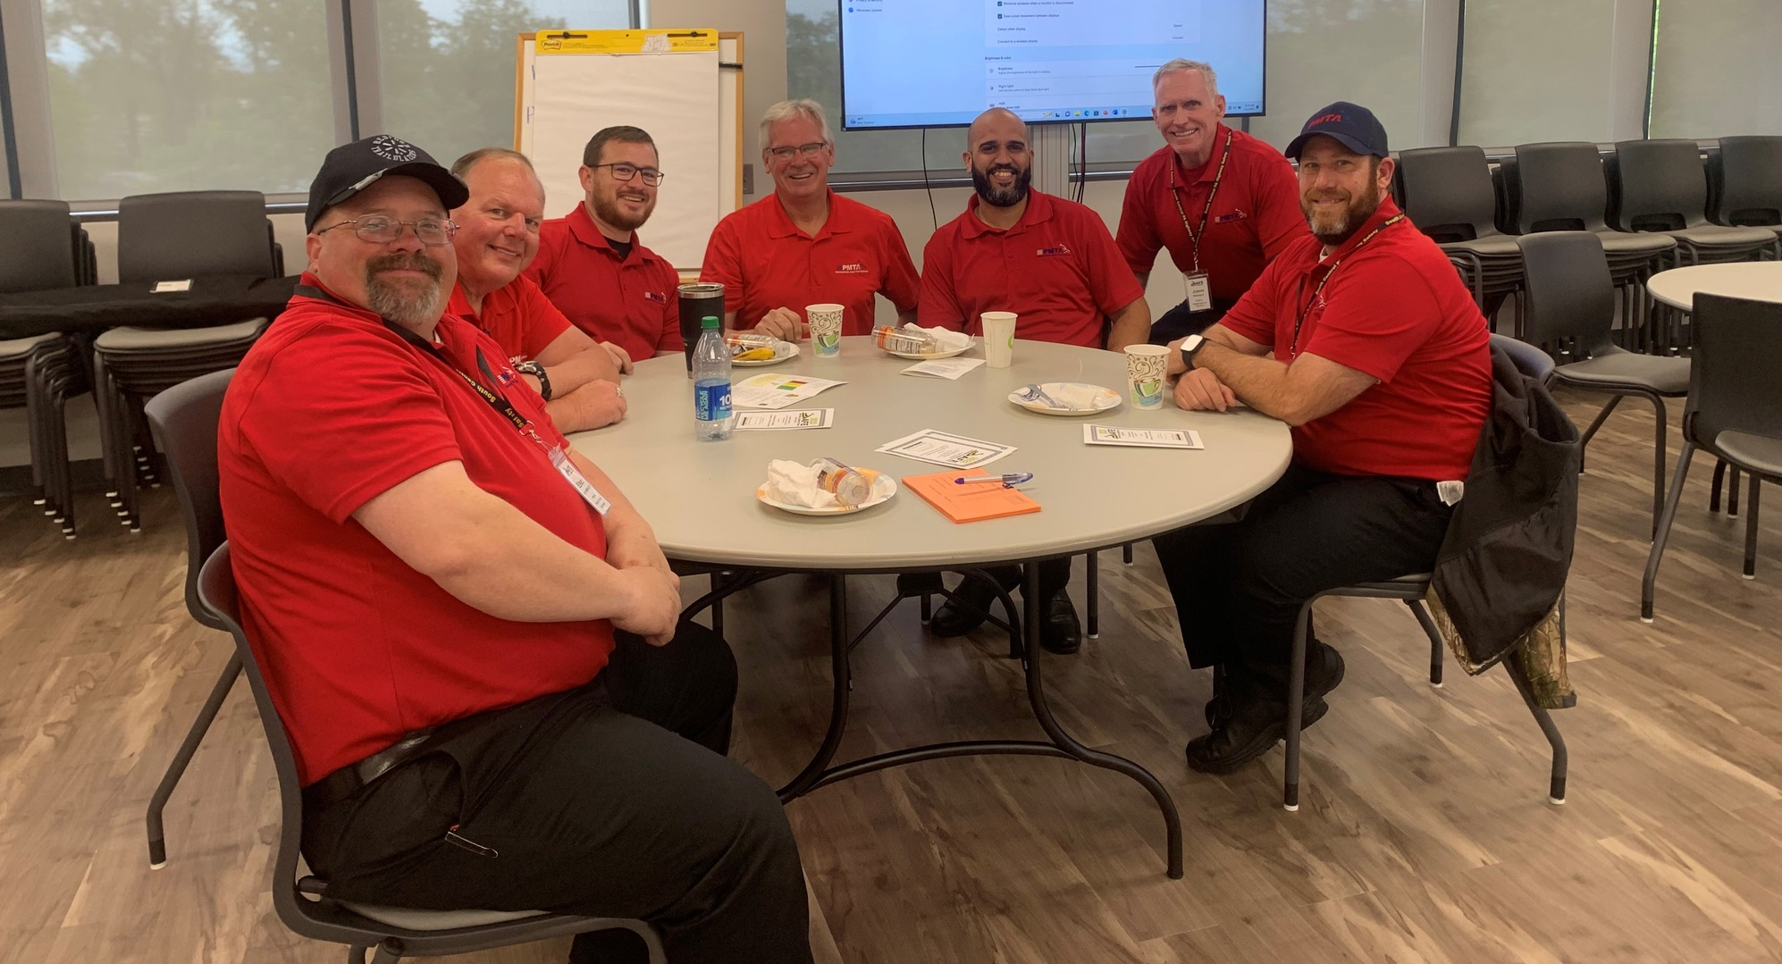
PA Road Team

Slide 9
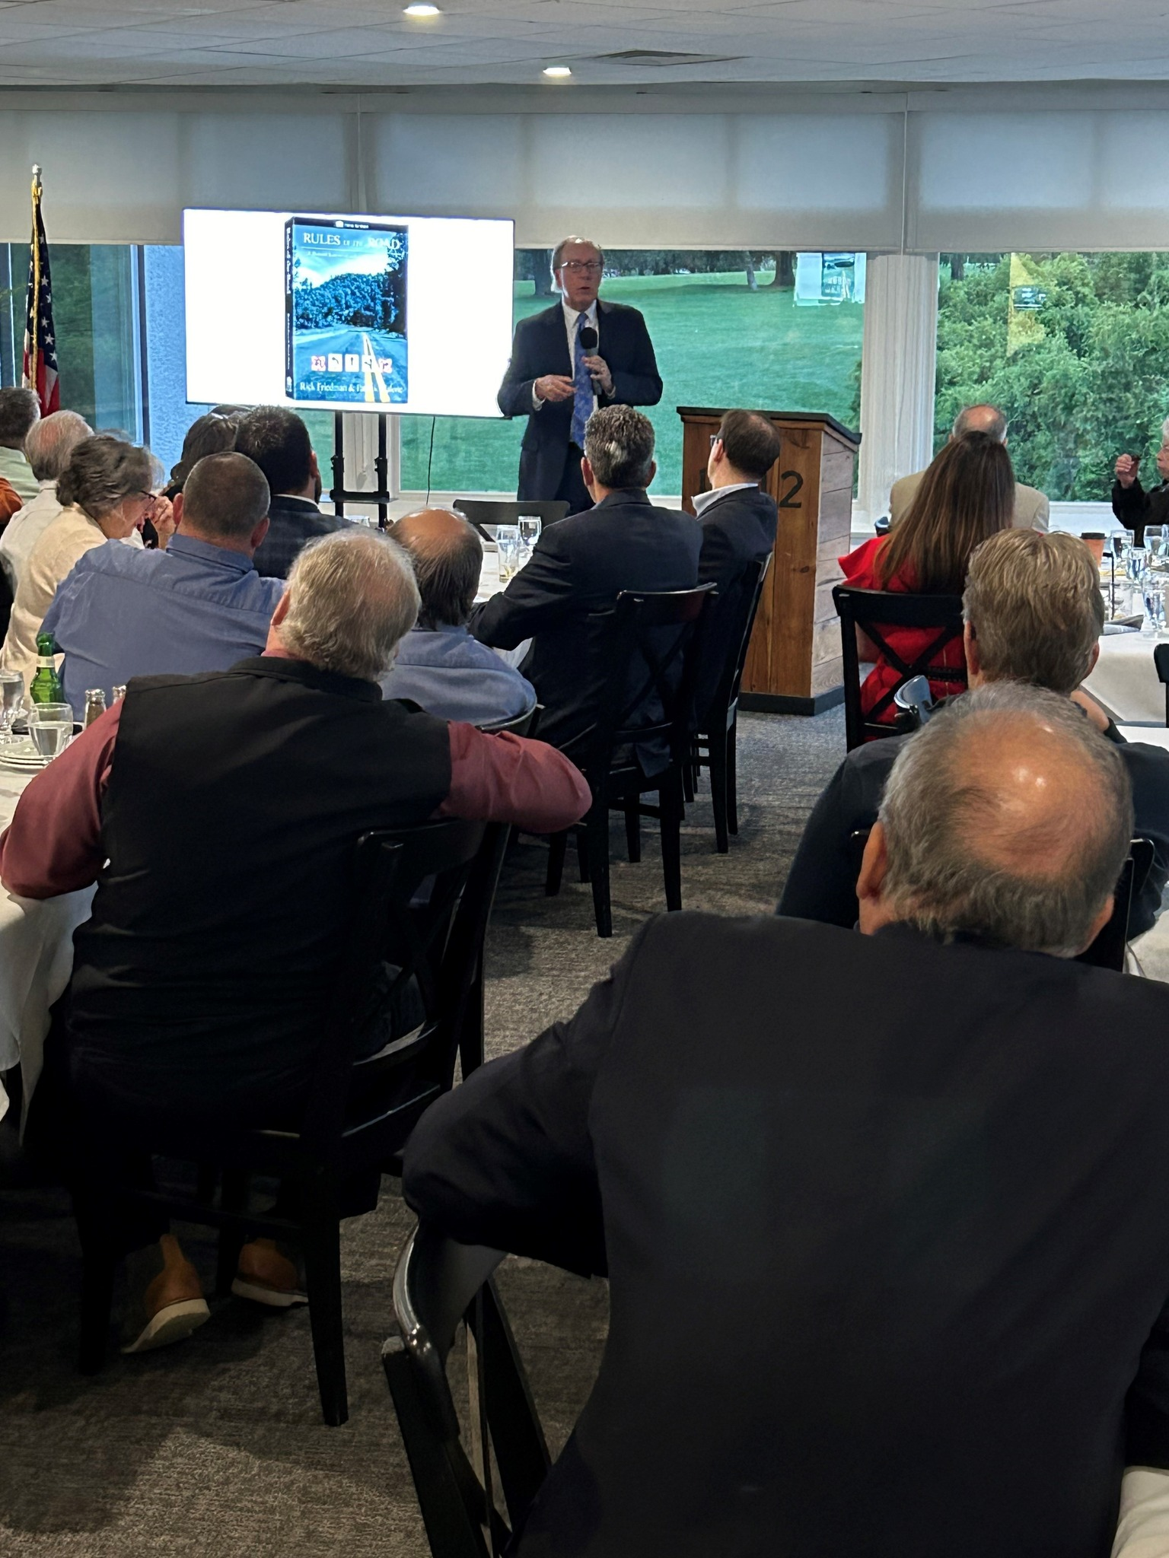
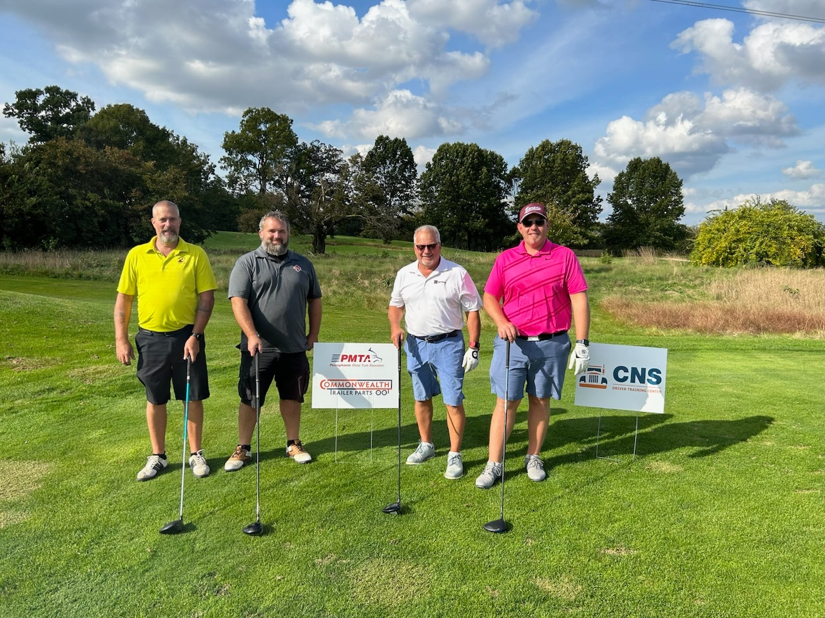
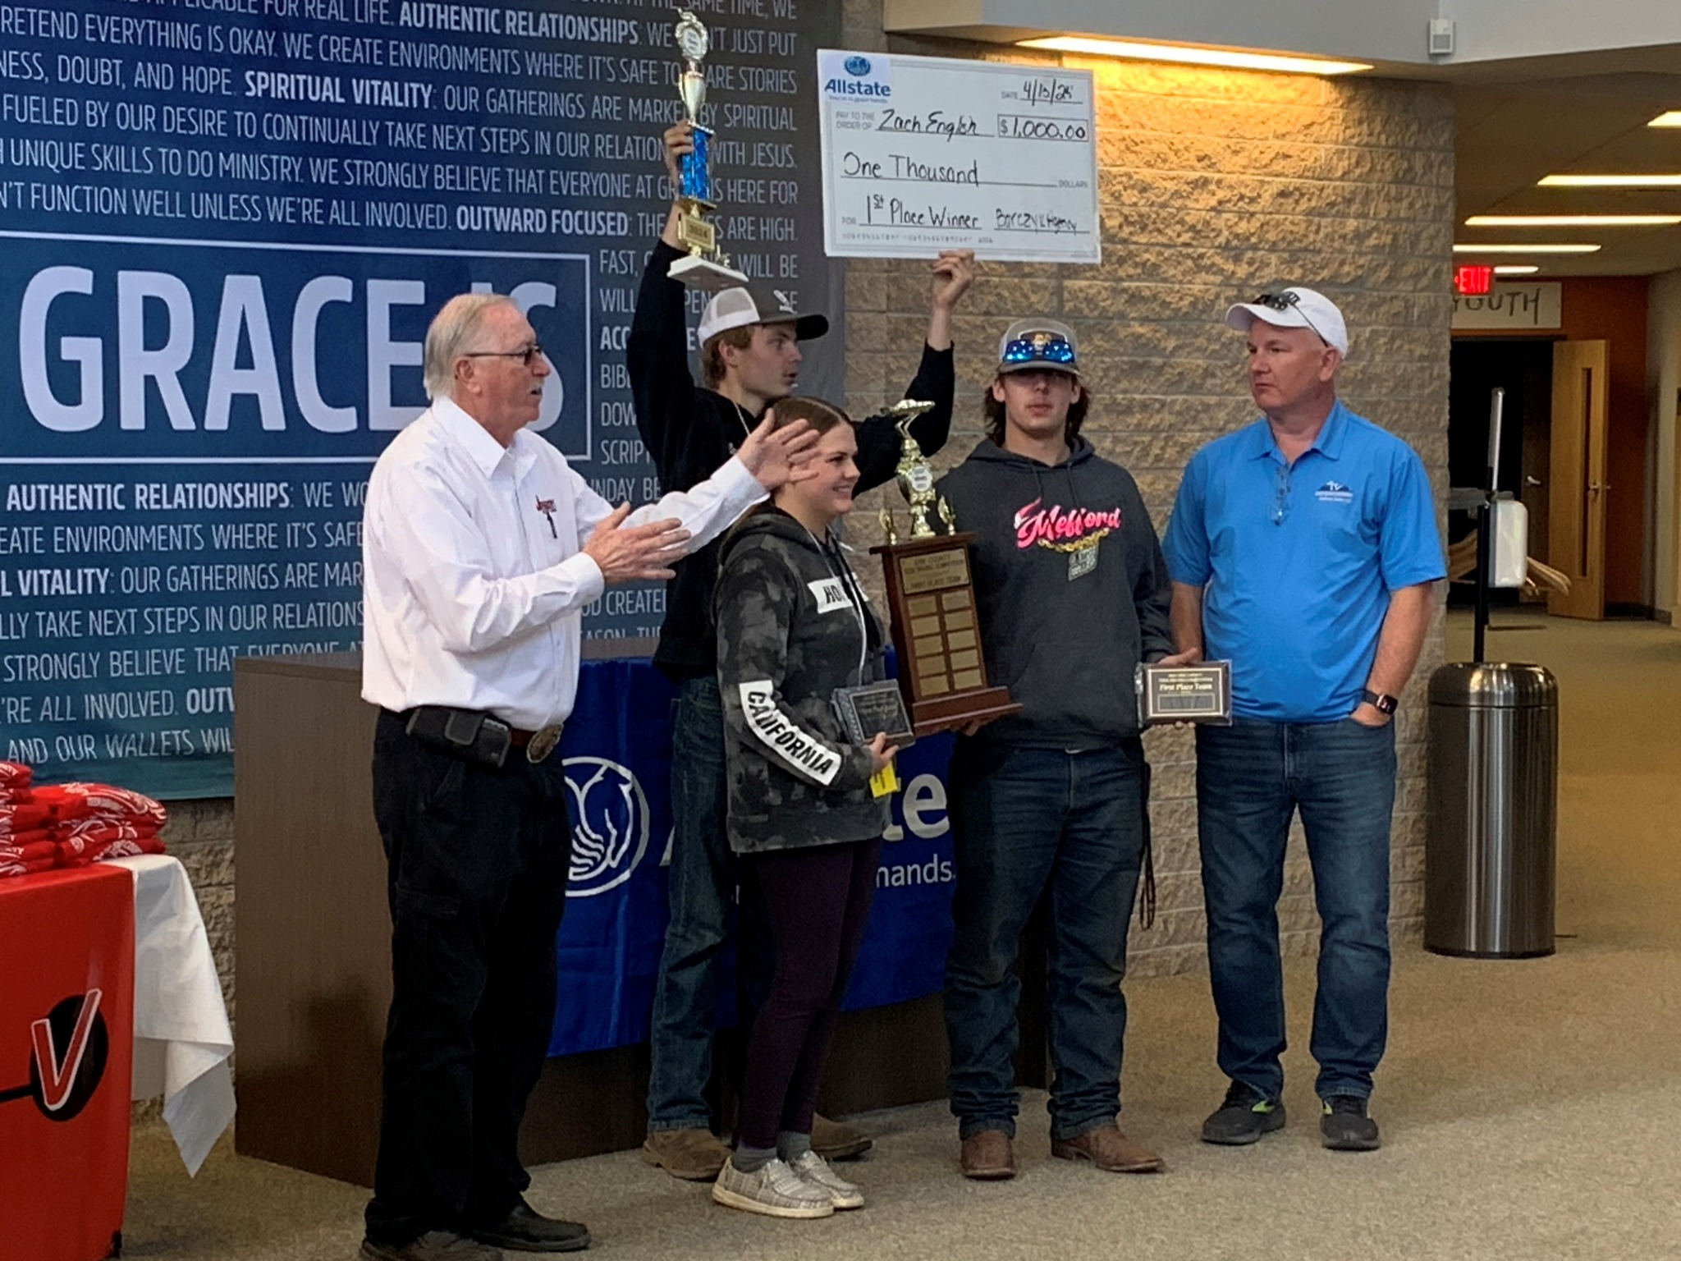
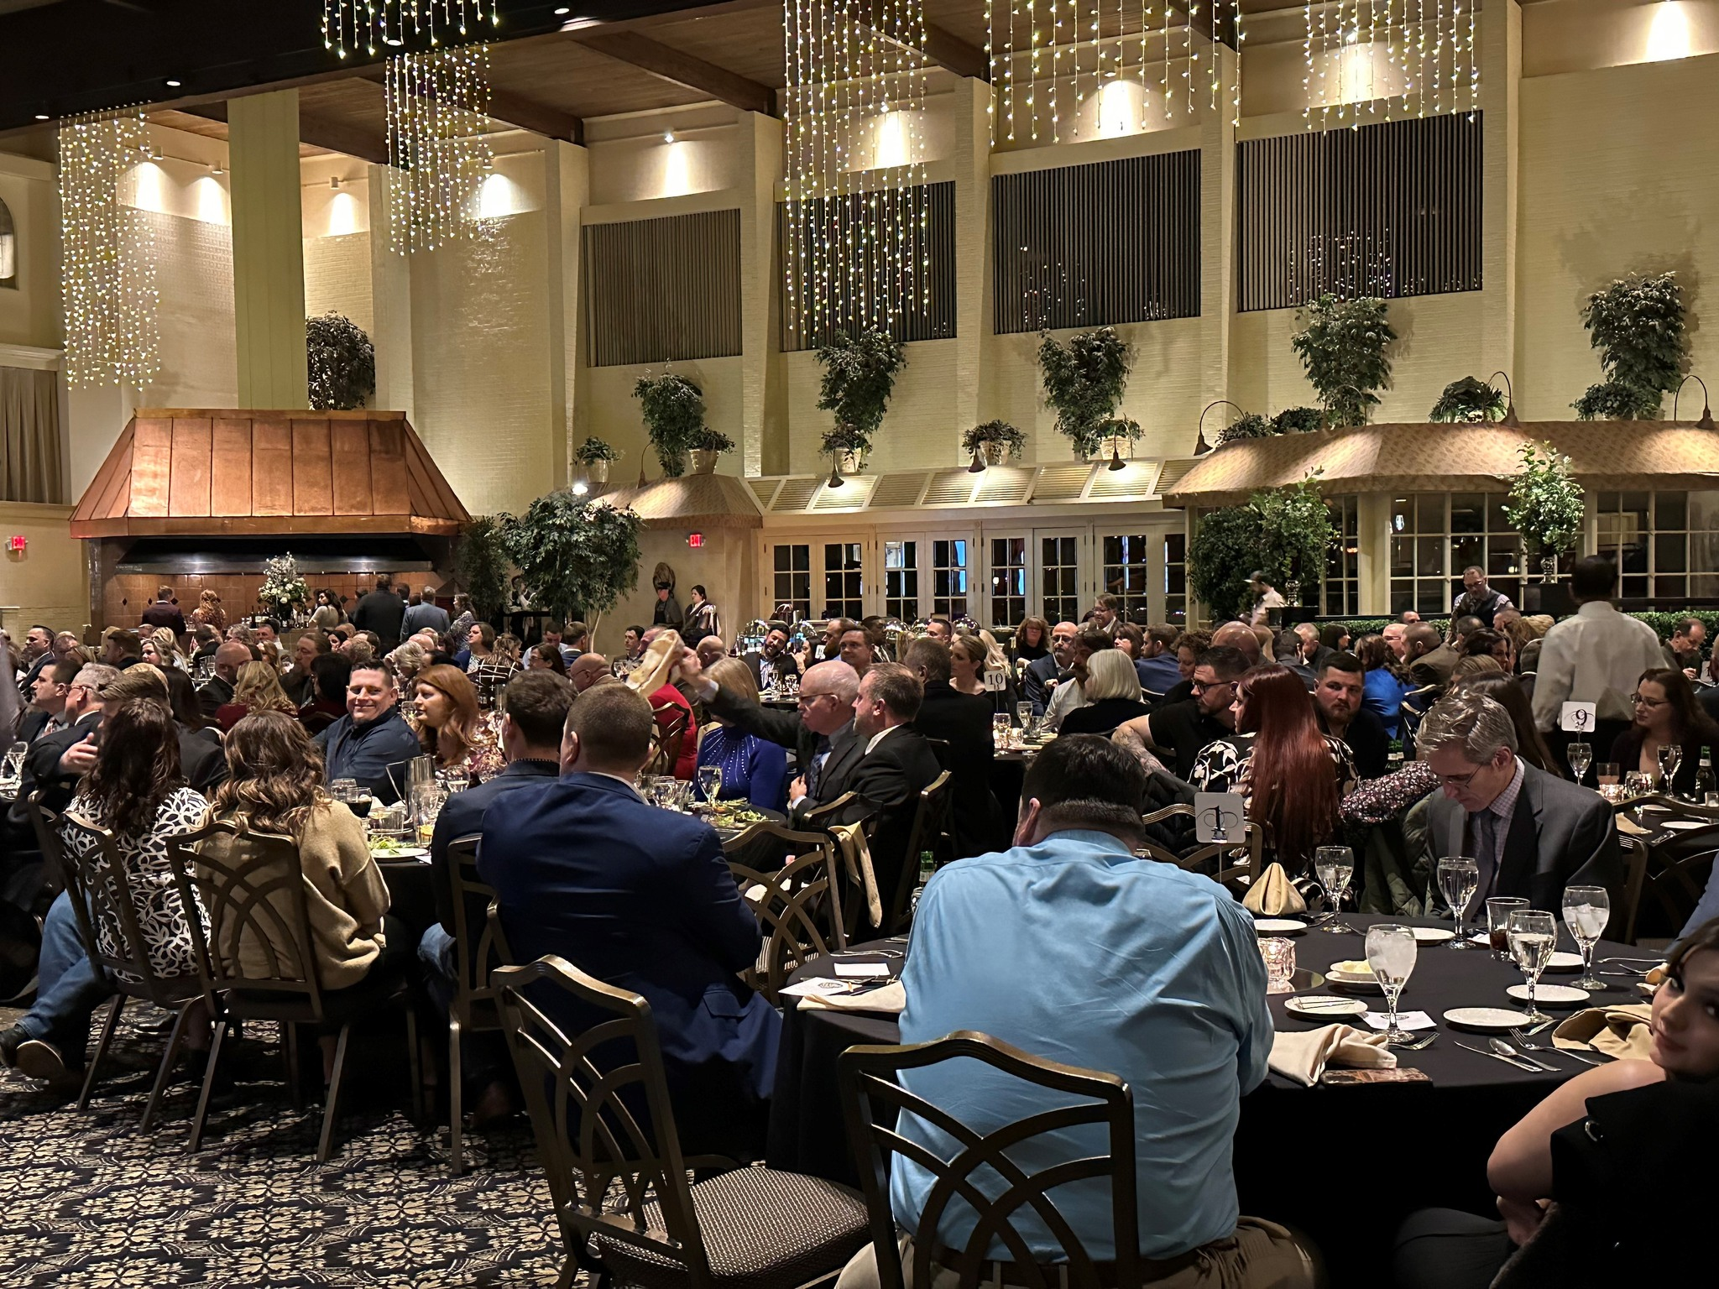
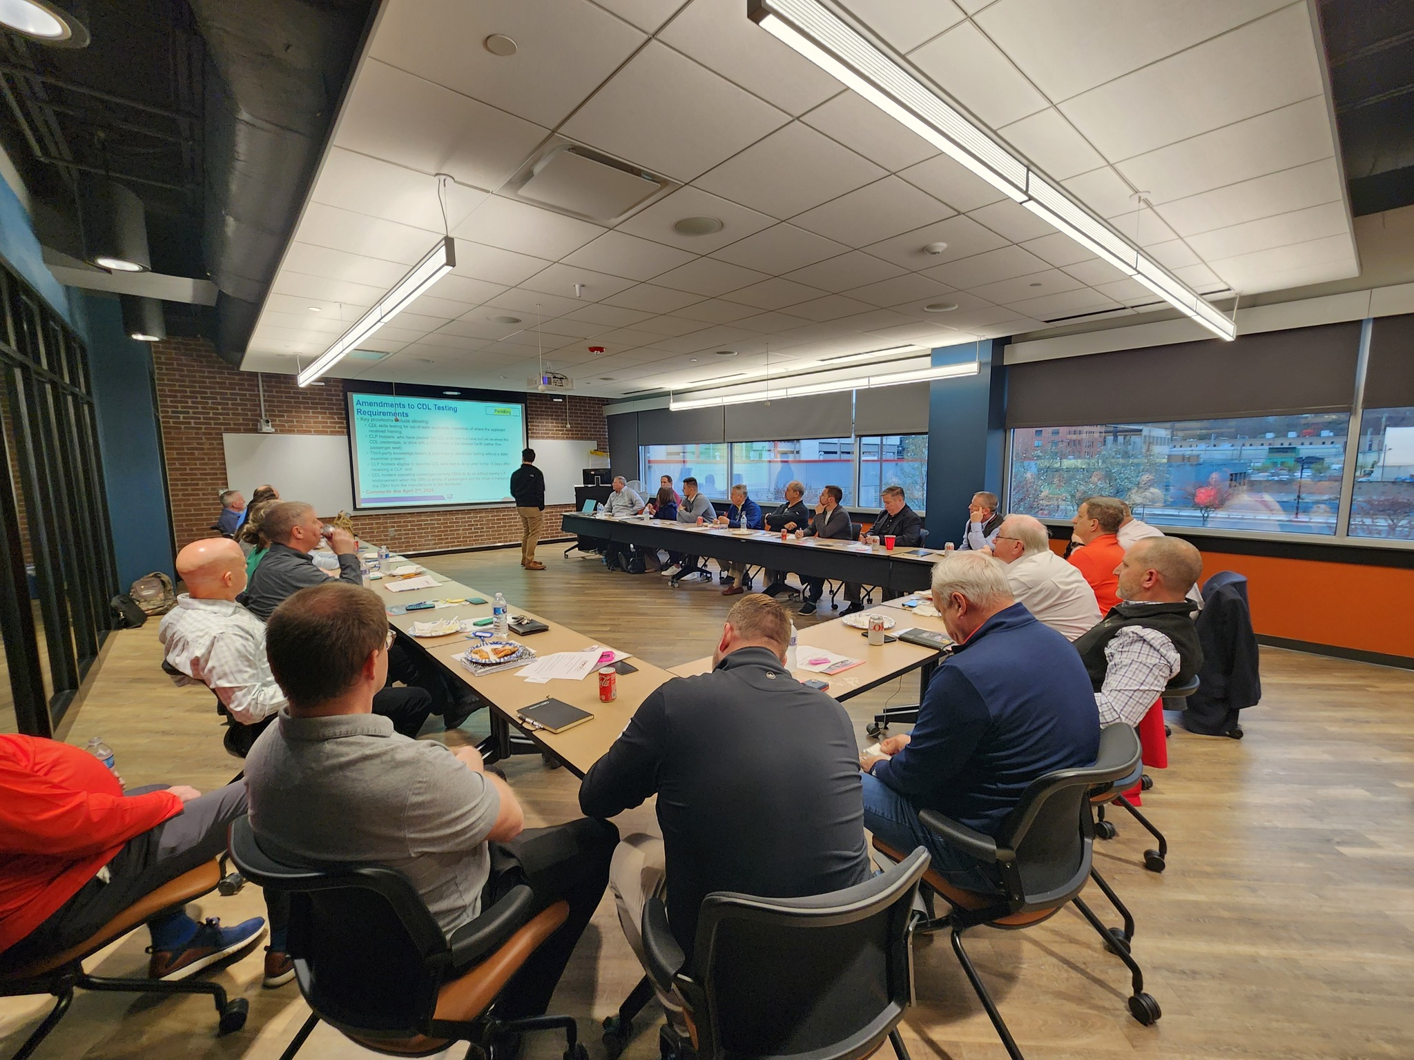
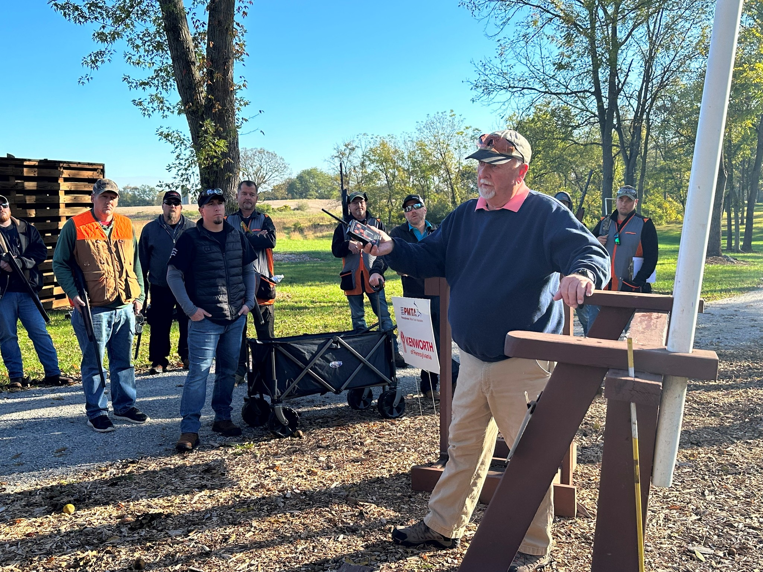
Notes:
Kelly

Slide 10
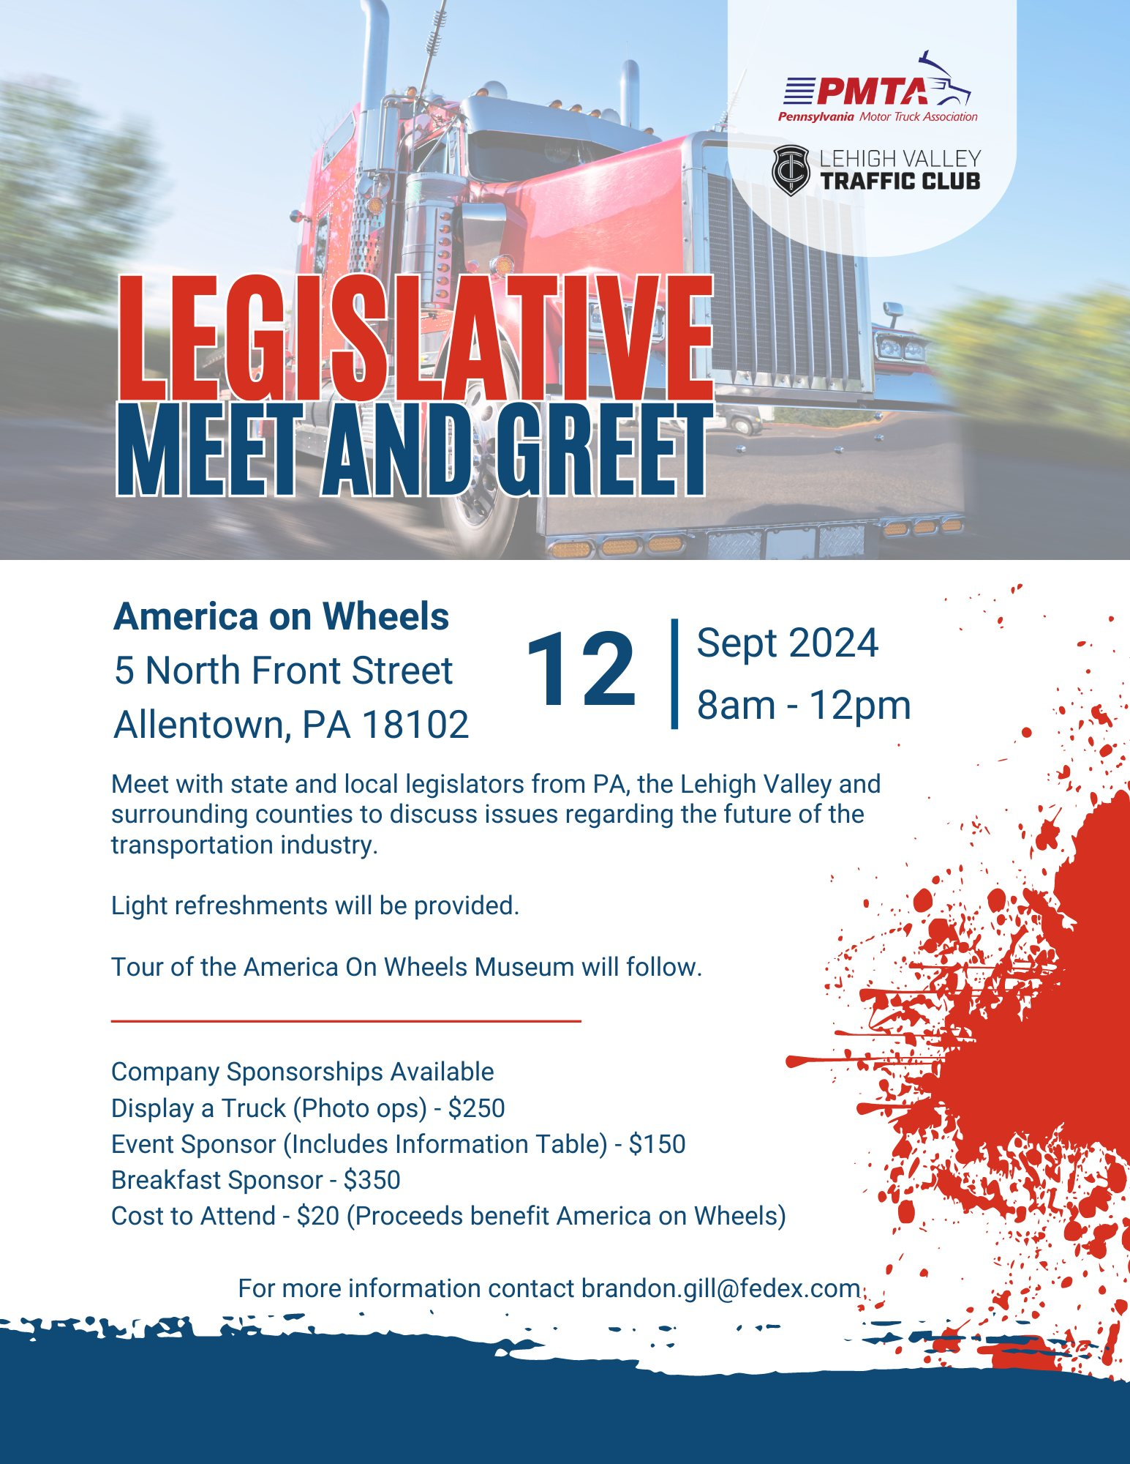
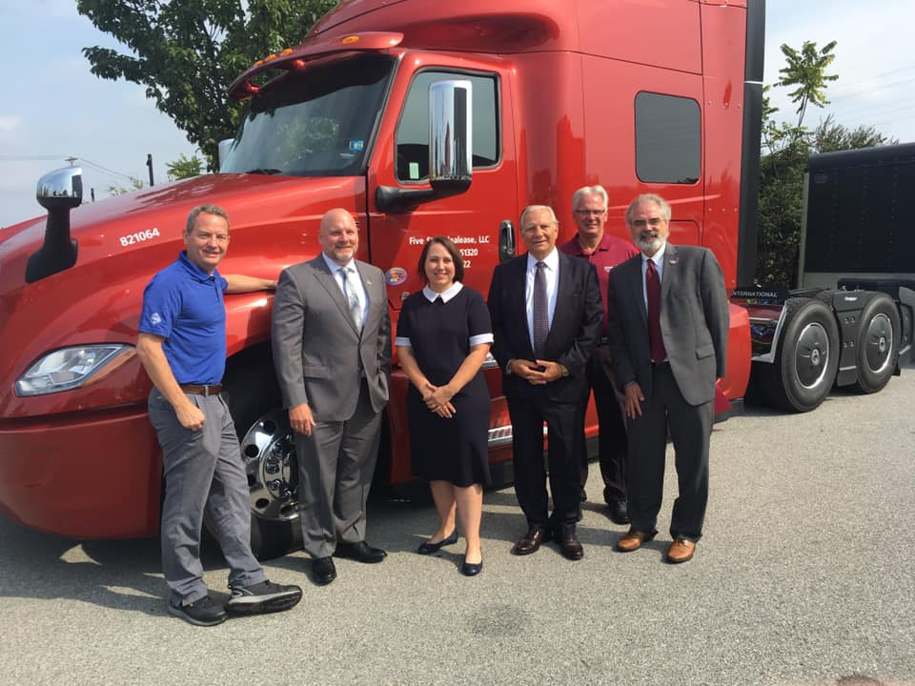
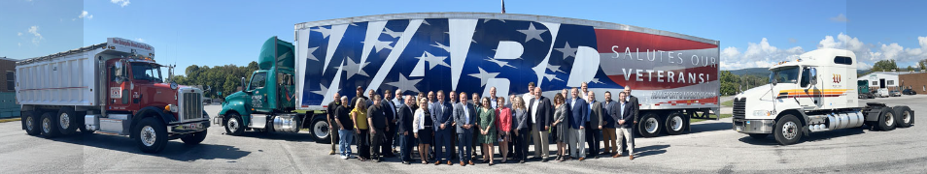
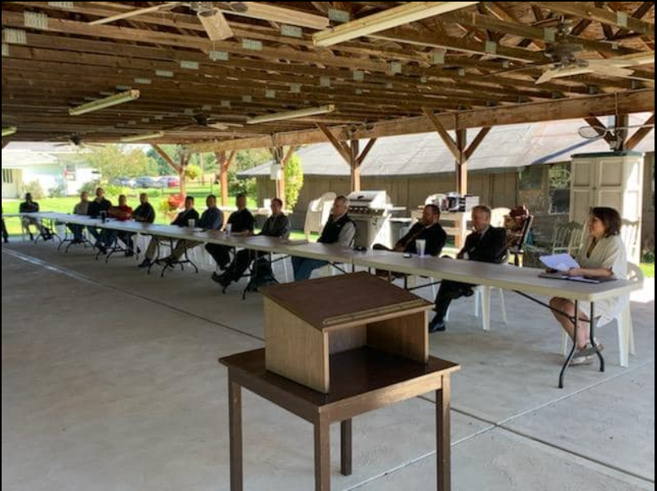
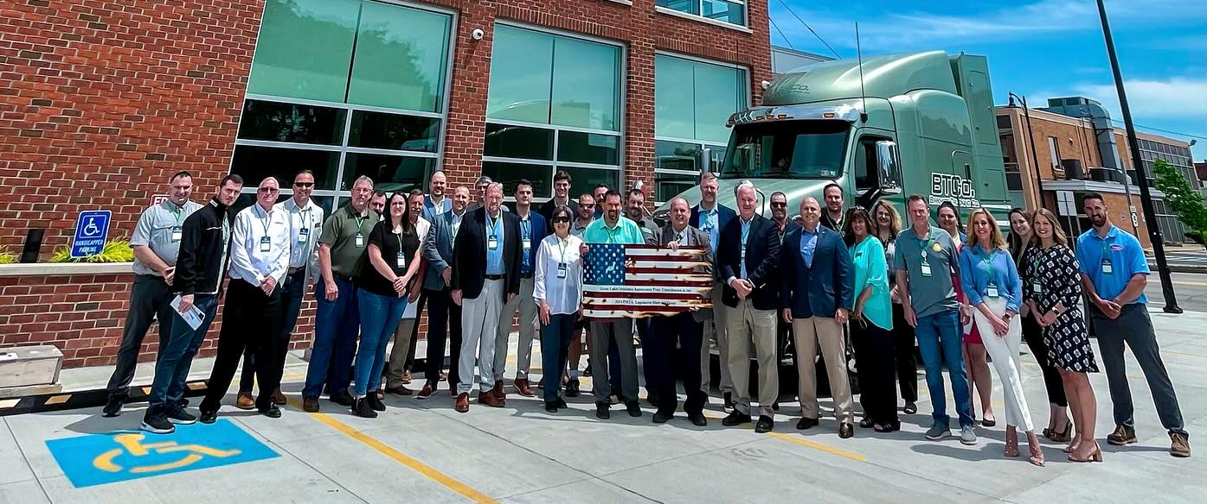

Slide 11

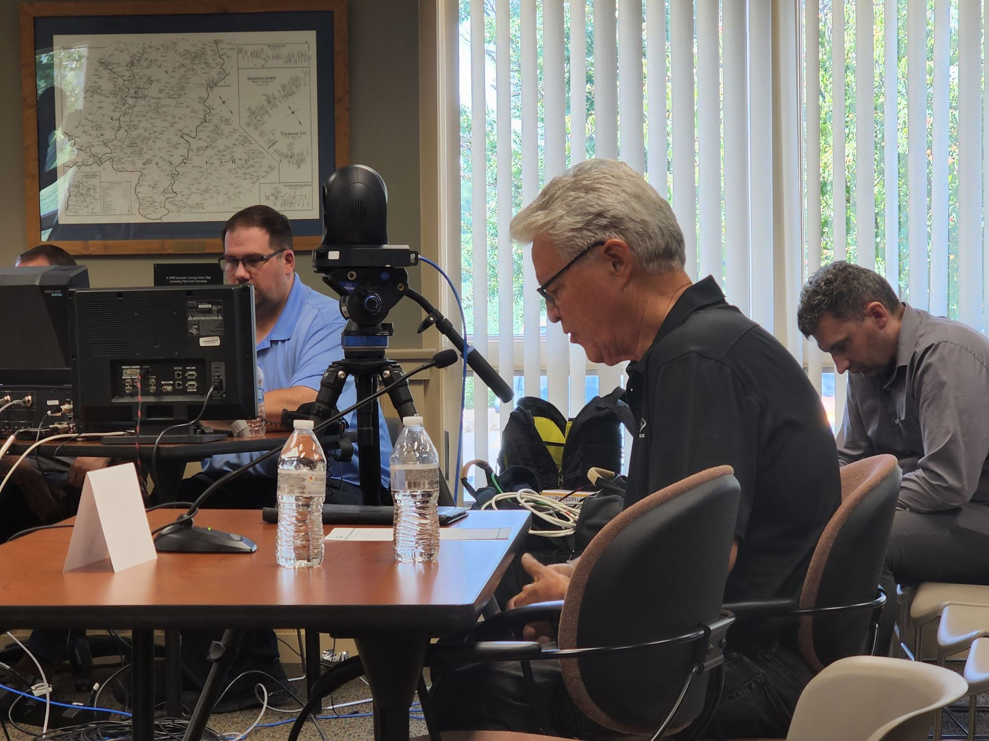

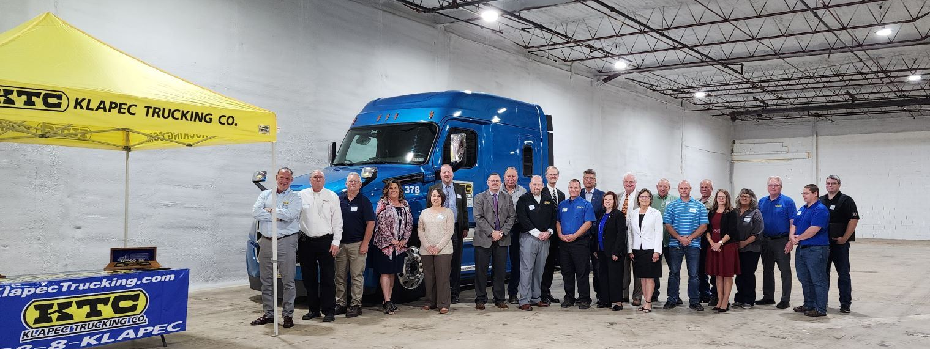
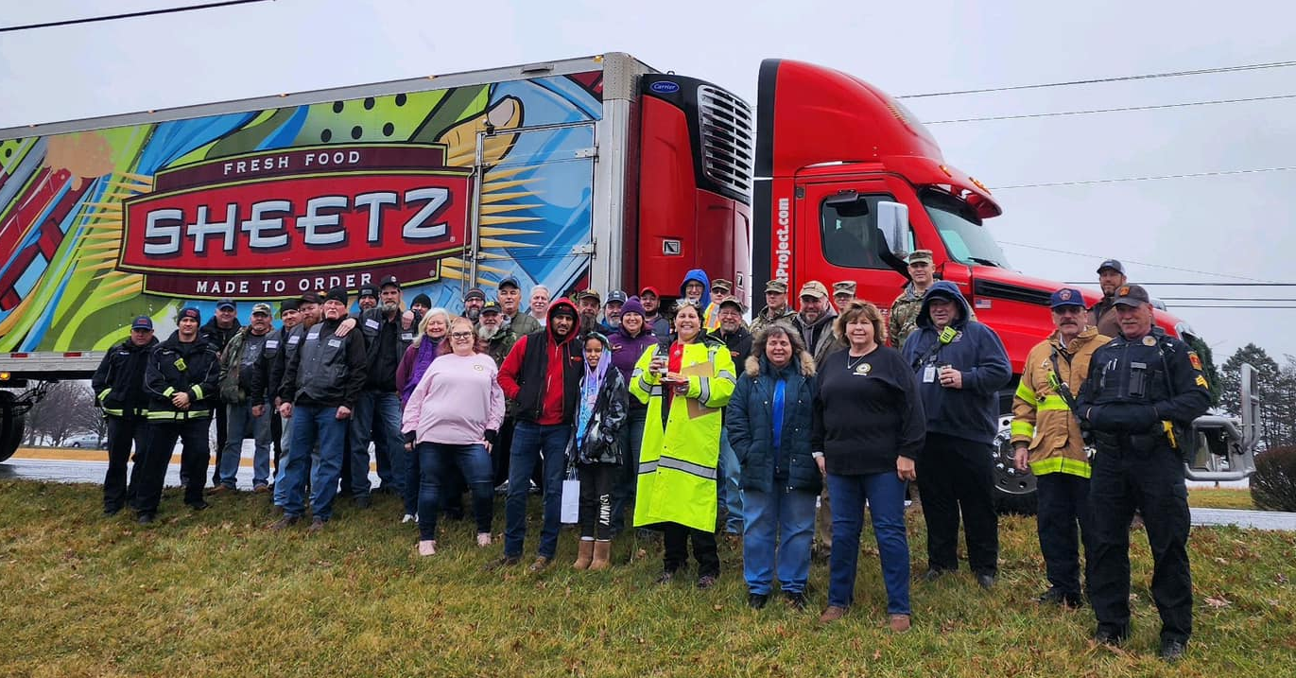
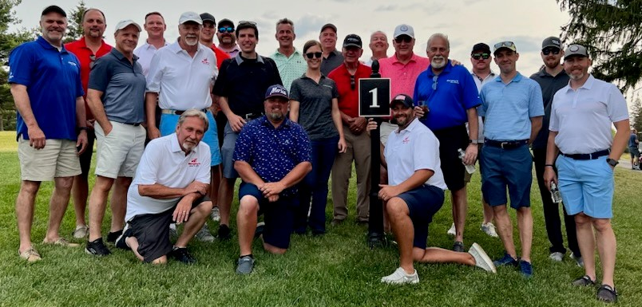

Slide 12
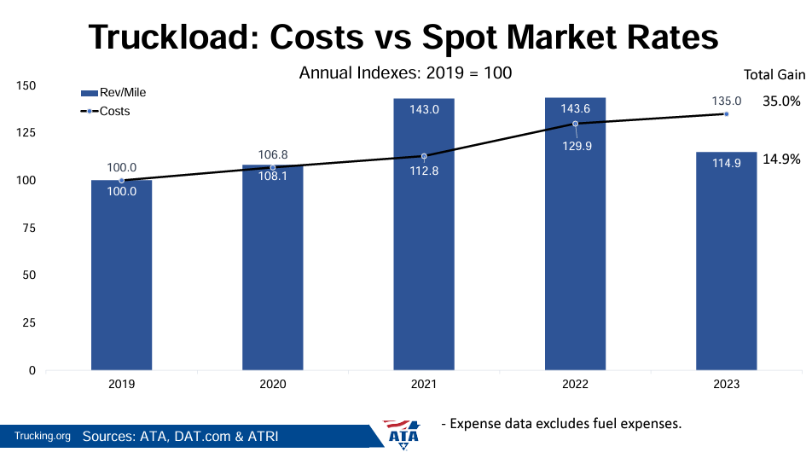

Slide 13
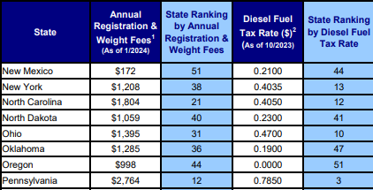

Slide 14
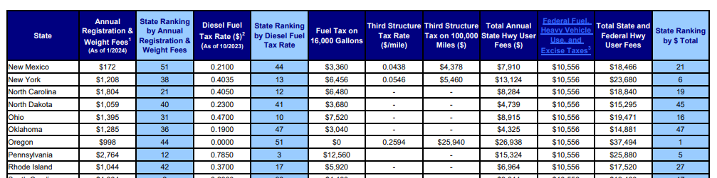

Slide 15
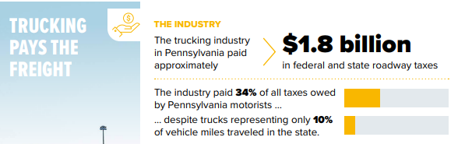

Slide 16
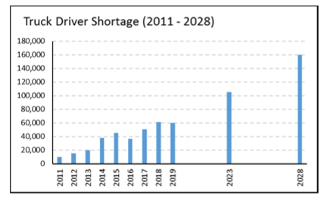
https://www.trucking.org/news-insights/ata-releases-updated-driver-shortage-report-and-forecast

Slide 17
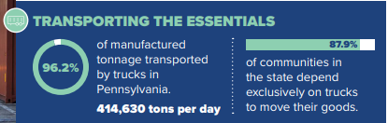

Slide 18
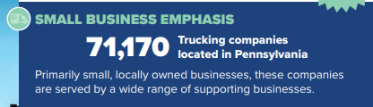

Slide 19
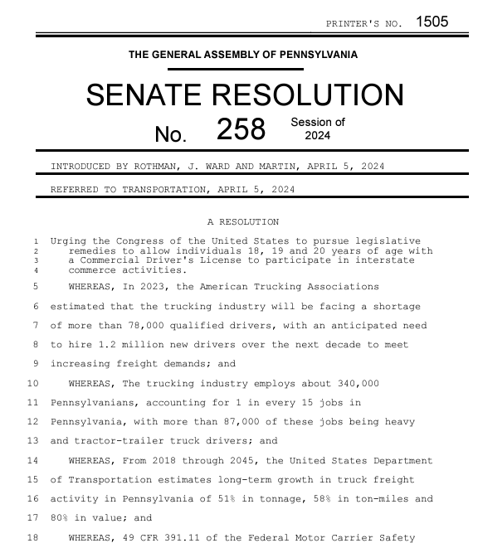

Slide 20
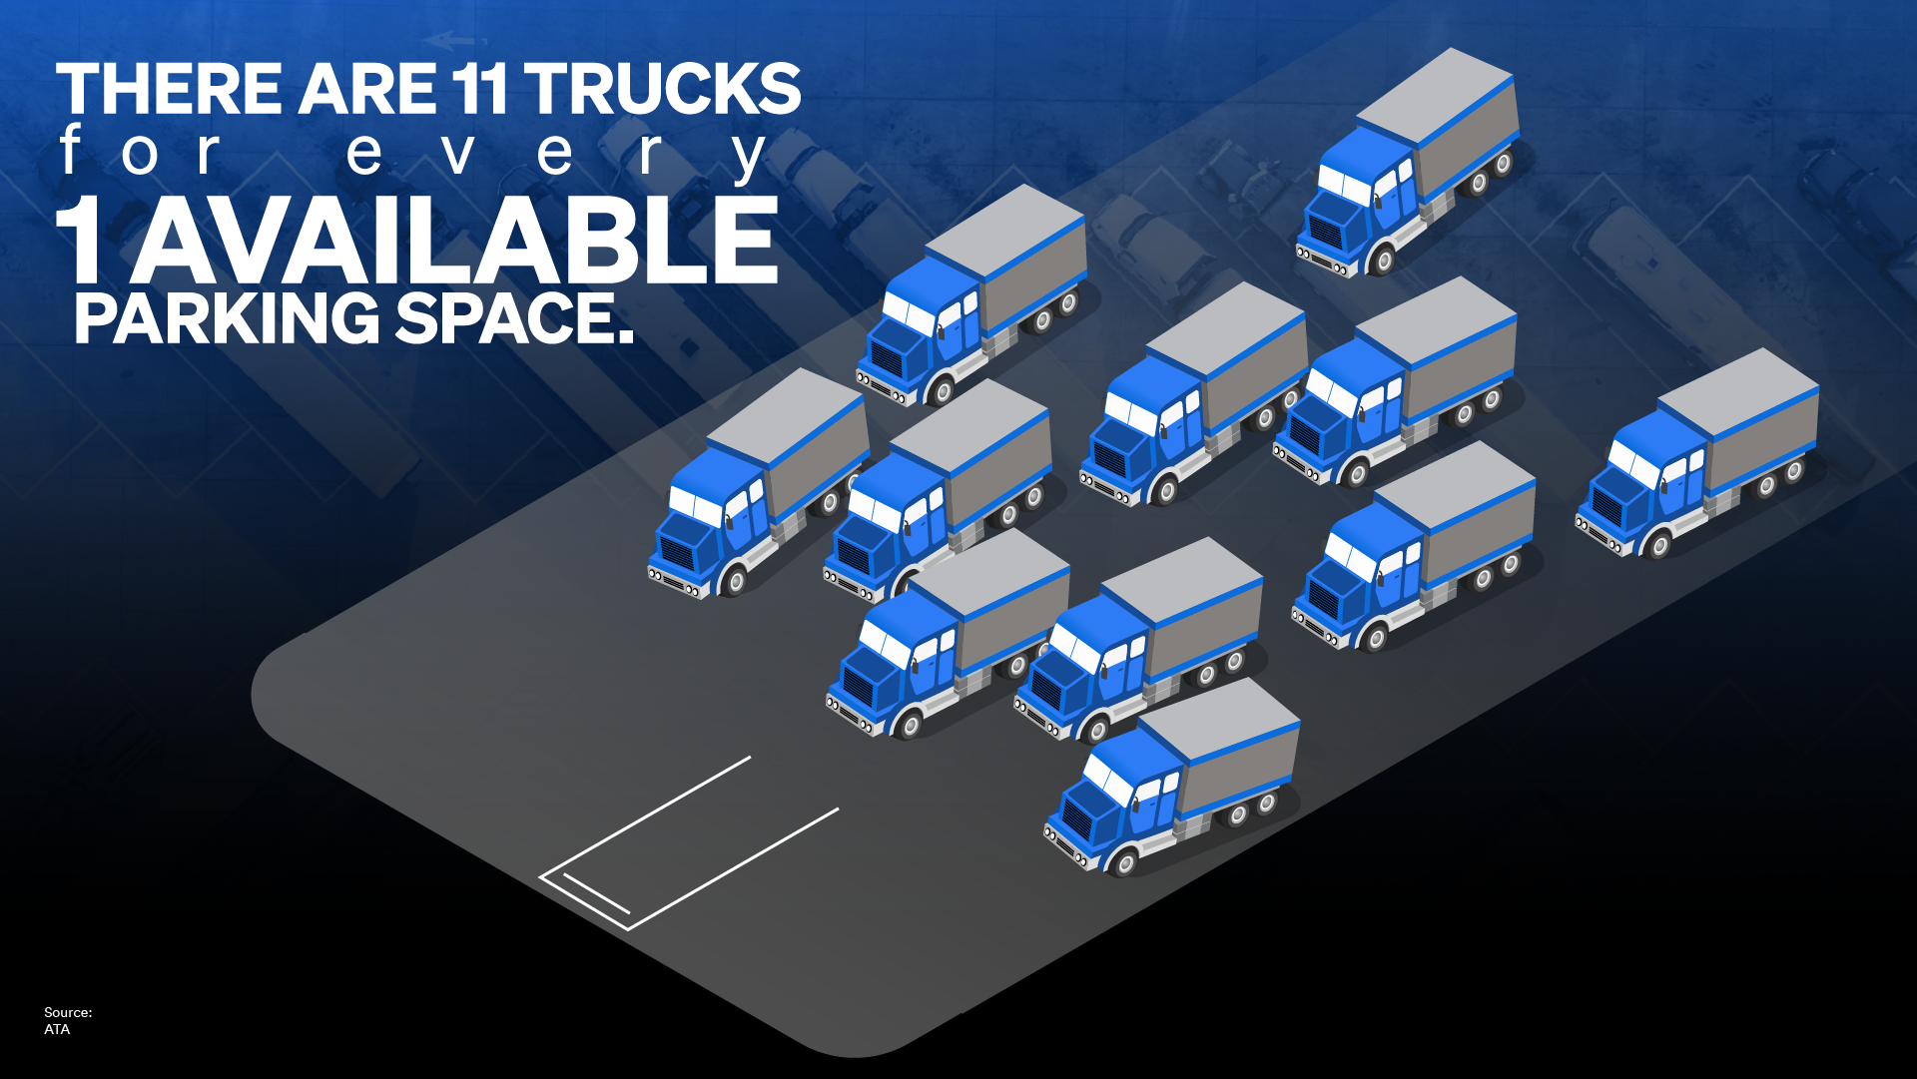

Slide 21
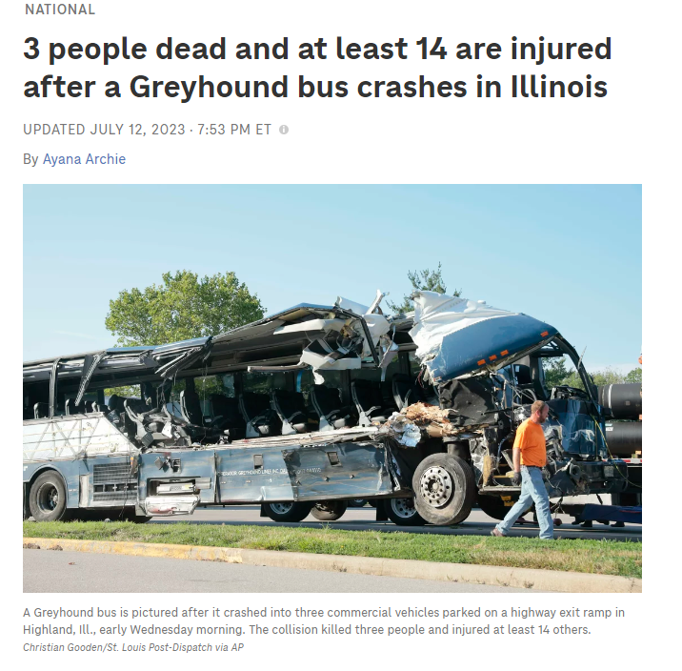

Slide 22
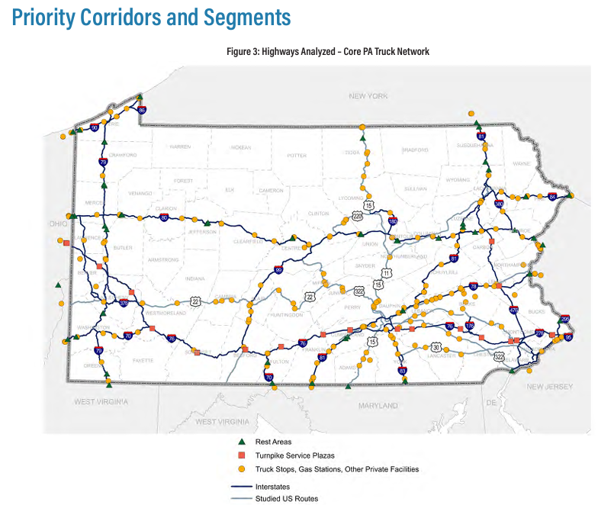

Slide 23
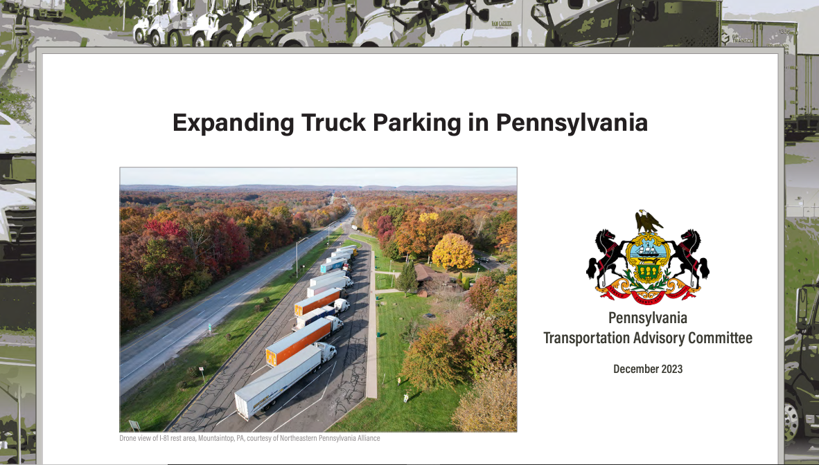

Slide 24
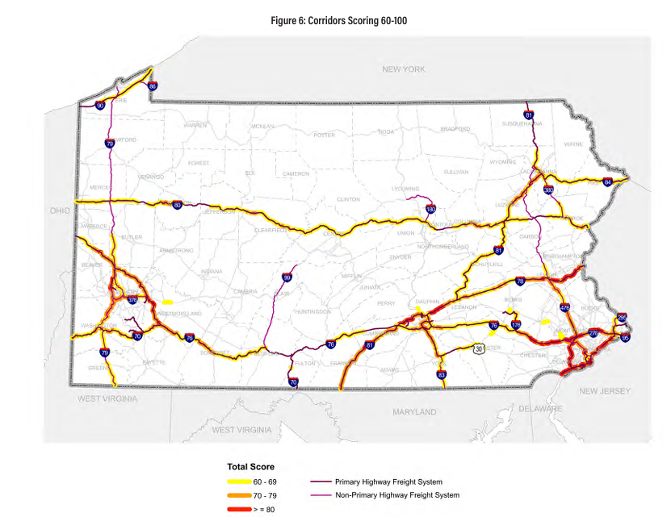

Slide 25
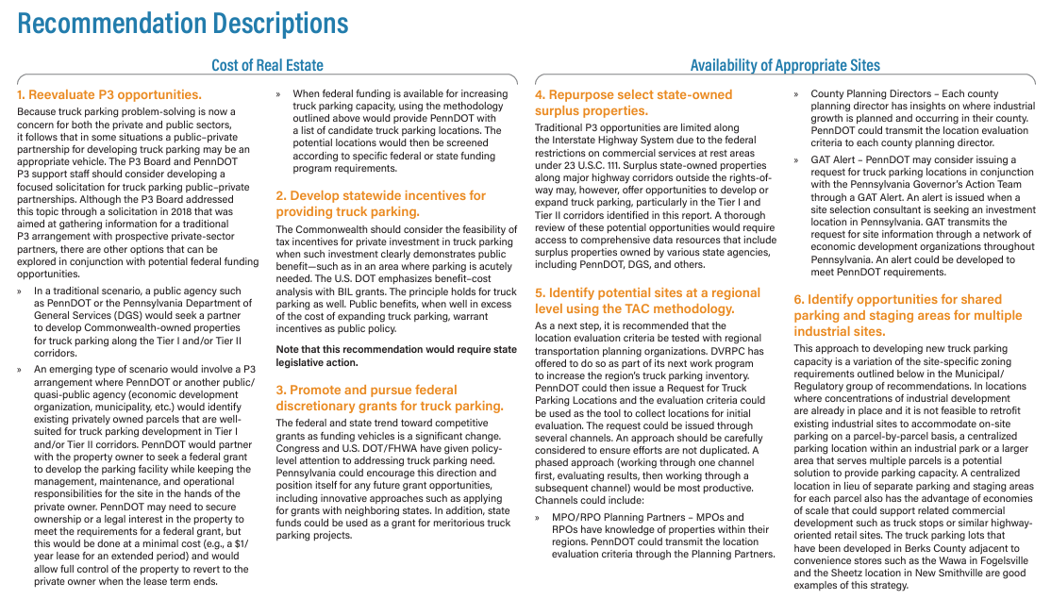

Slide 26
Omnibus Low-NOx Rule in PA
Adopted in 2002 and in effect MY04 and after
PA adopted CA’s regulation by reference
Trucks may not be sold, imported, delivered, purchased, leased, rented, acquired, or received if they don’t comply with CARB emissions requirements
When CARB rules update, PA rules update automatically
Rules were similar to EPA’s until recently

Slide 27
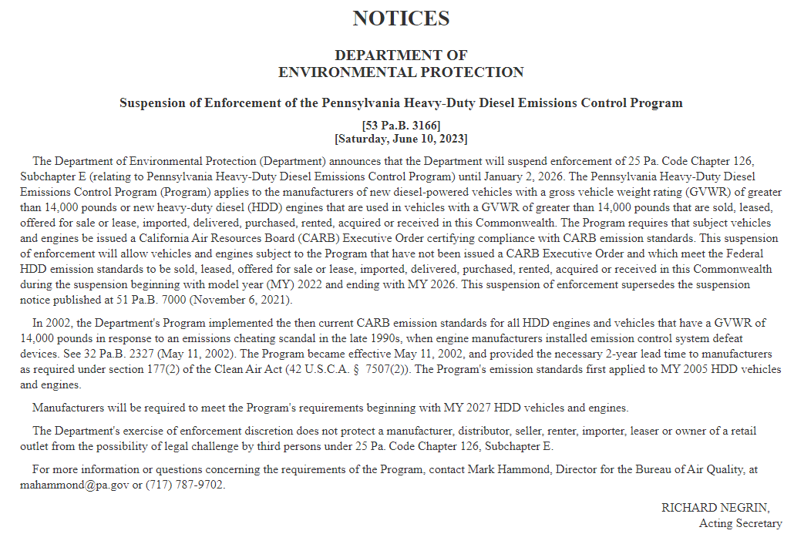

Slide 28
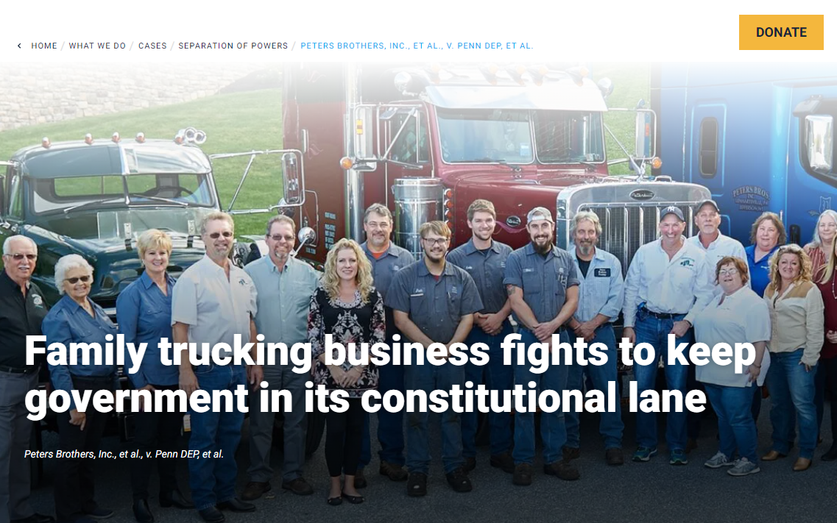

Slide 29
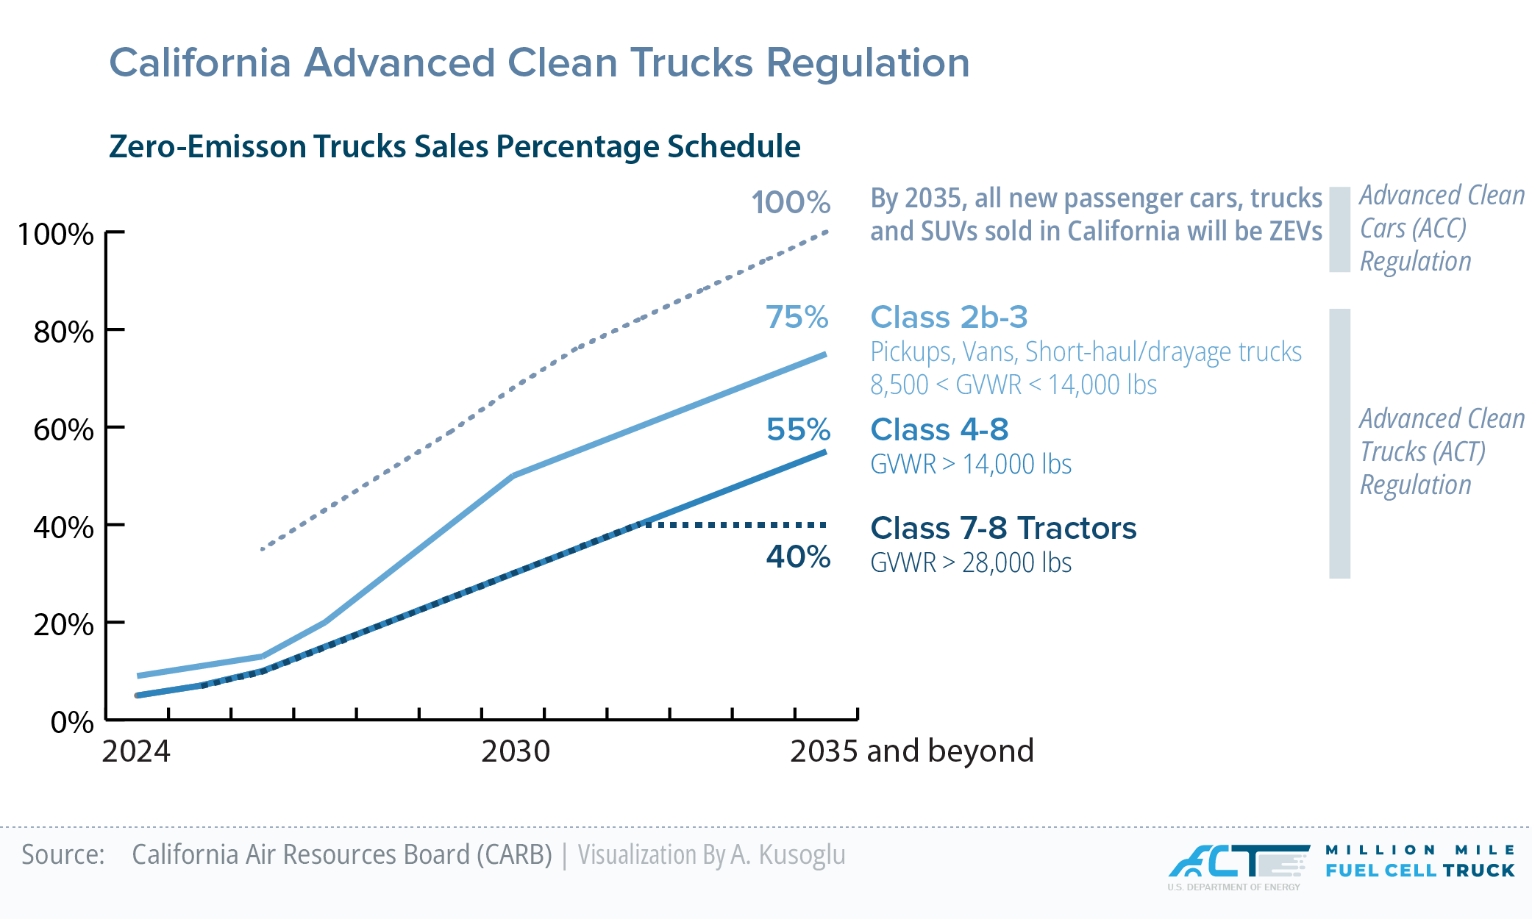

Slide 30
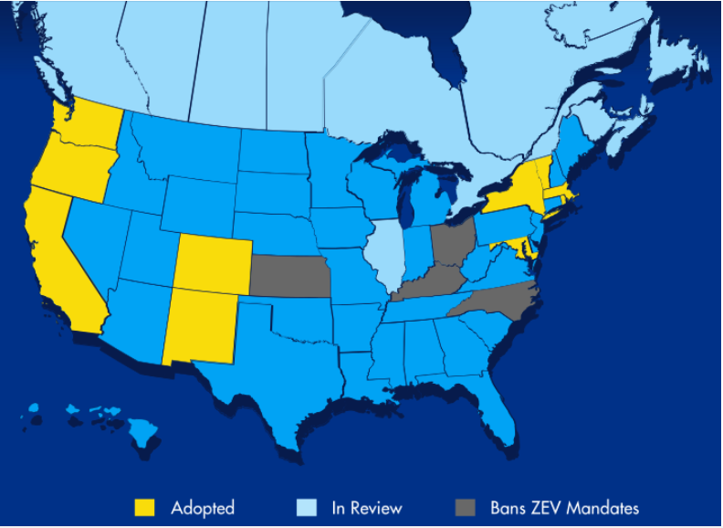
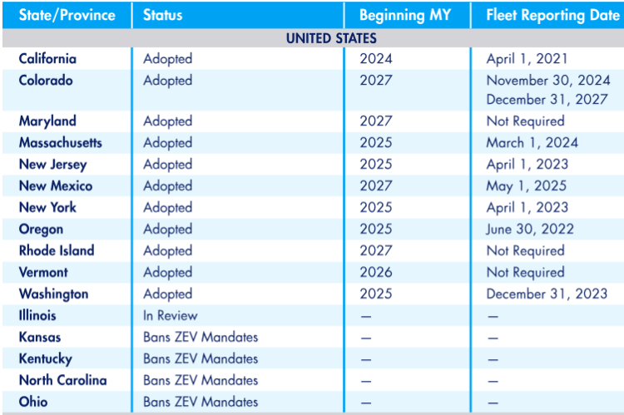
Advanced Clean Trucks Rule
https://www.gladstein.org/trending-topic/advanced-clean-truck-rule/

Slide 31
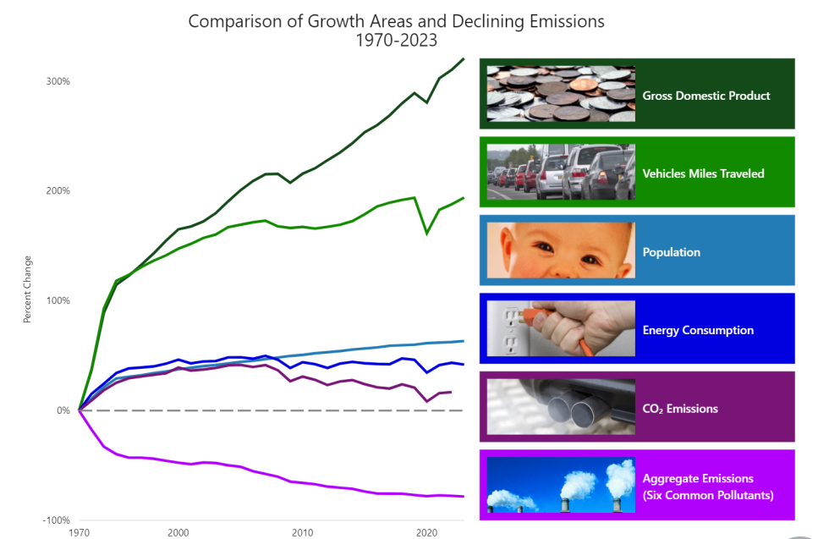
https://www.epa.gov/transportation-air-pollution-and-climate-change/accomplishments-and-successes-reducing-air#:~:text=Compared%20to%201970%20vehicle%20models,percent%20cleaner%20than%201970%20models.

Slide 32
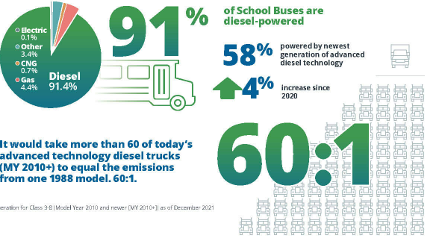
Fact: Diesel Emissions
https://dieselforum.org/trucking

Slide 33
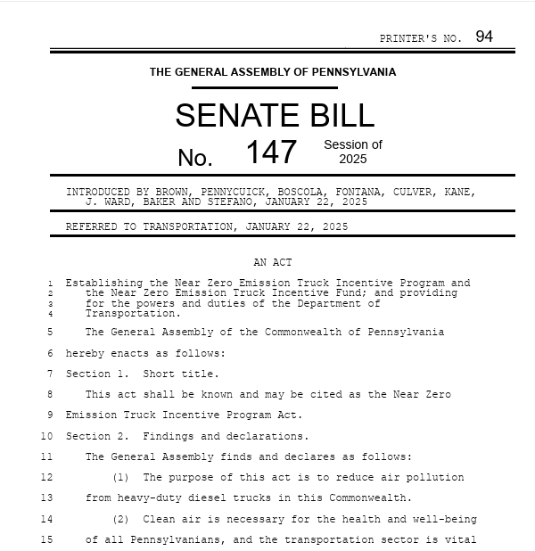

Slide 34
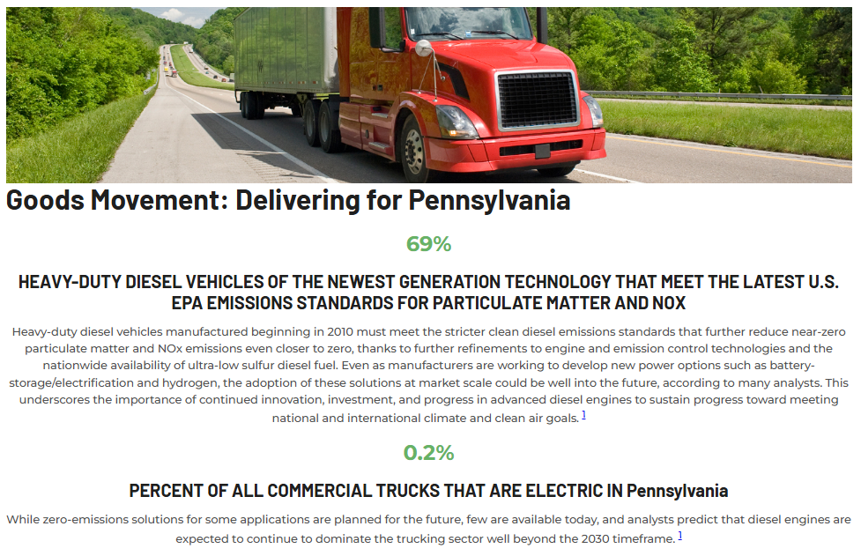
https://enginetechforum.org/in-your-state

Slide 35
PMTA’s Team
Rebecca Oyler – President & CEO
Wendy Palermo – Operations Manager/Titling & Registration
Anthony Cloud – Director of Safety & Education
David McCord – Director of Member Engagement
Megan Magensky – Director of Communications
Brian Rider – Advocacy Manager
Michelle Timmermans – Administrative Assistant

Slide 36

Rebecca Oyler www.pmta.org royler@pmta.org
(717) 761-7122

